Slide 1
Dynamic attractor equivalence classes for n=5 graphs
There are 145 dynamic attractors pooled across 103 mECs representing 1053 graphs. Although distinct within each class, there is a lot of repetition across classes. Here we have sorted the attractors into the following categories:
3-cycle (slide 2)
4-cycle (slide 43)
4-cycu (slide 54)
4-ufd (slide 72)
4-cycu and 4-ufd oddballs (slide 97)
Extended 4-cycu and 4-ufd (slide 105)
Cyclic union: point + 2-clique + 2-clique (slide 111)
Cyclic union: point + 3-clique + point (slide 119)
Cyclic union: point + 3-cycle + point (slide 123)
Envelopes (slide 131)
Fusion 3-cycle (slide 140)
Other fusions: 4-cycle, 4-cycu, 4-ufd (slide 152)
5-cycle variations (slides 156)
Created by Carina Curto and Katherine Morrison (PIs) in collaboration with Caitlyn Parmelee, Sumita Garai, and Joshua Paik. August 16, 2020.

Slide 2
3-cycle

Slide 3
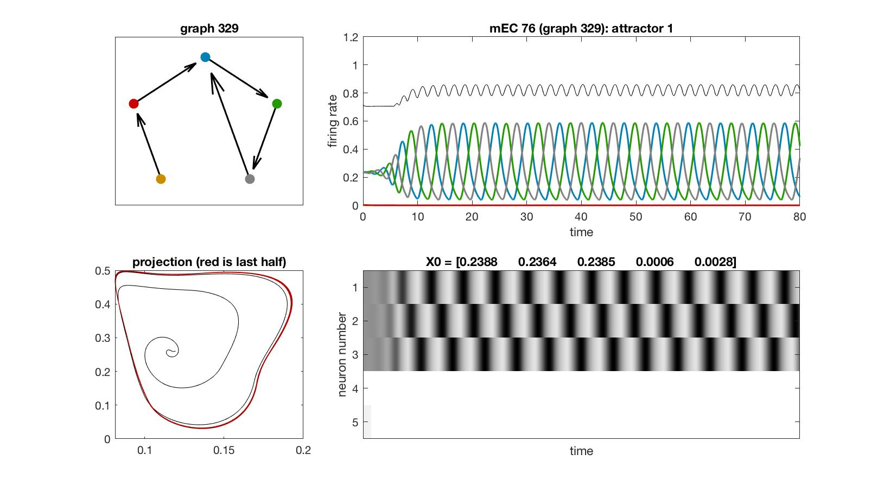
mEC 76

Slide 4
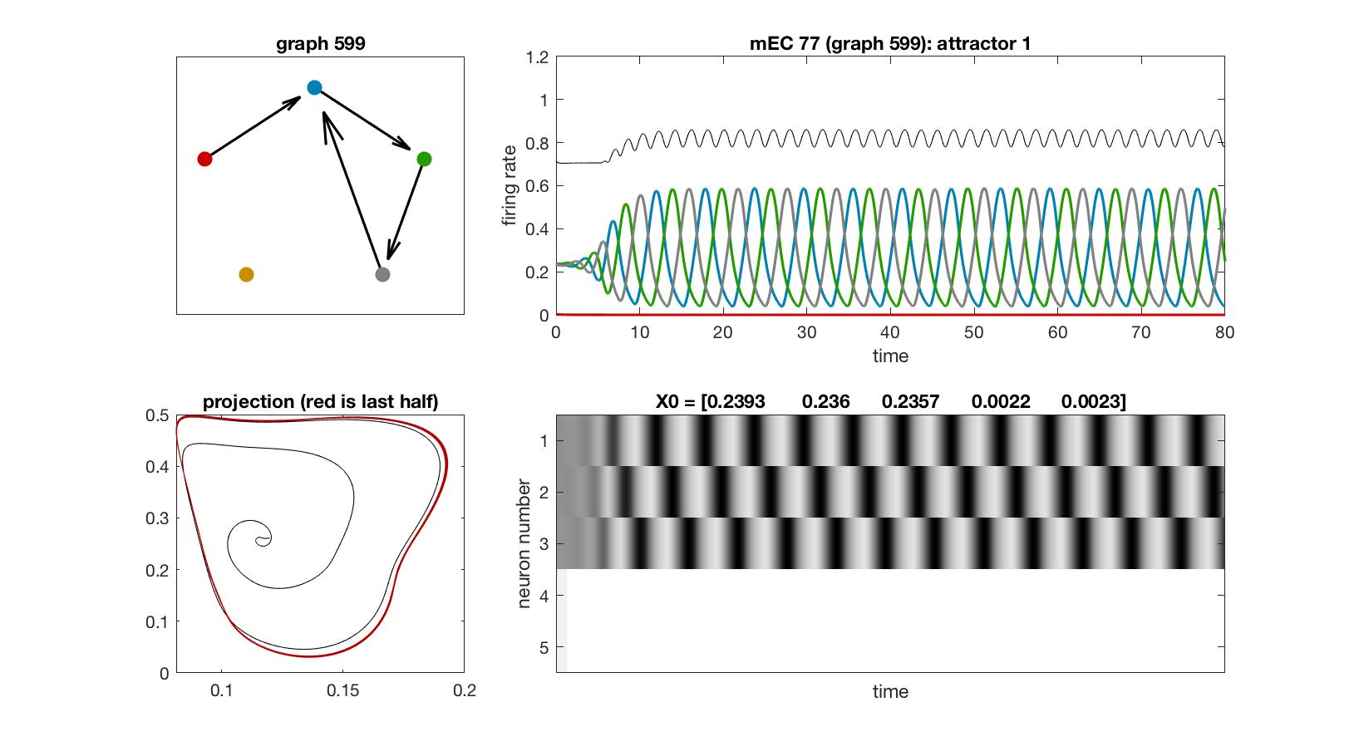
mEC 77

Slide 5
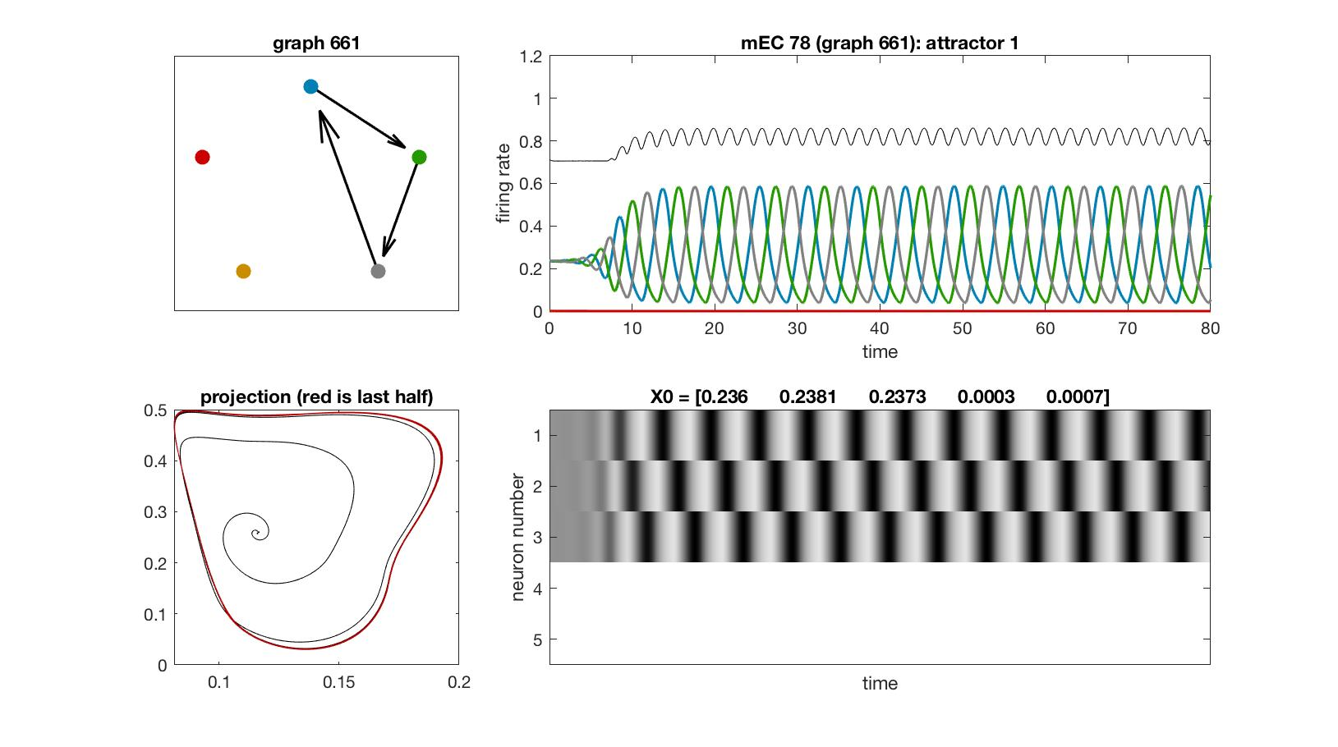
mEC 78

Slide 6
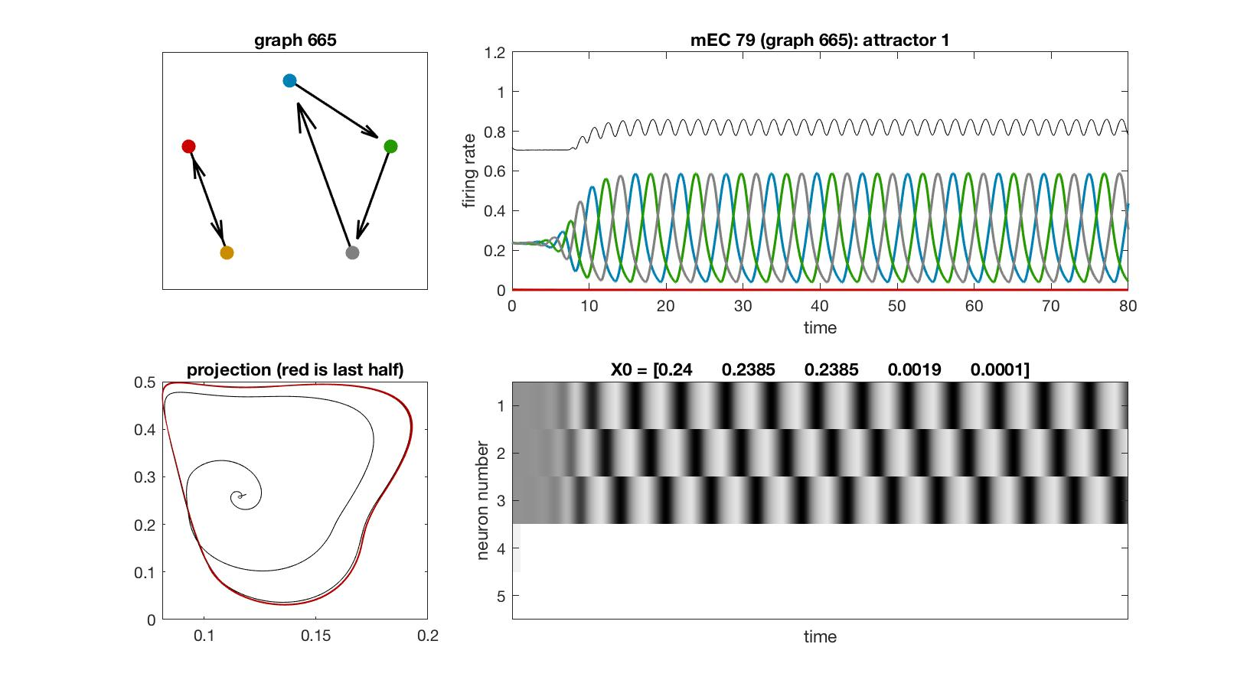
mEC 79

Slide 7
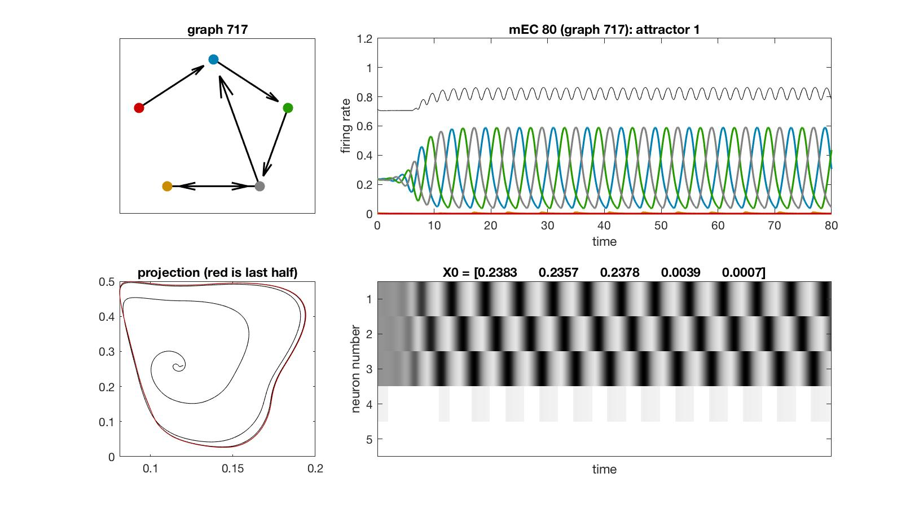
mEC 80

Slide 8
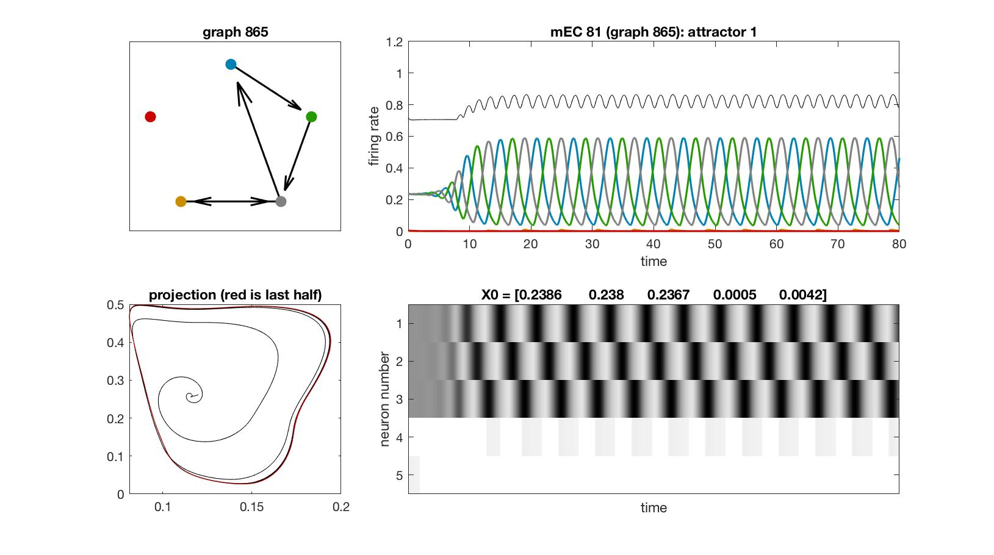
mEC 81

Slide 9
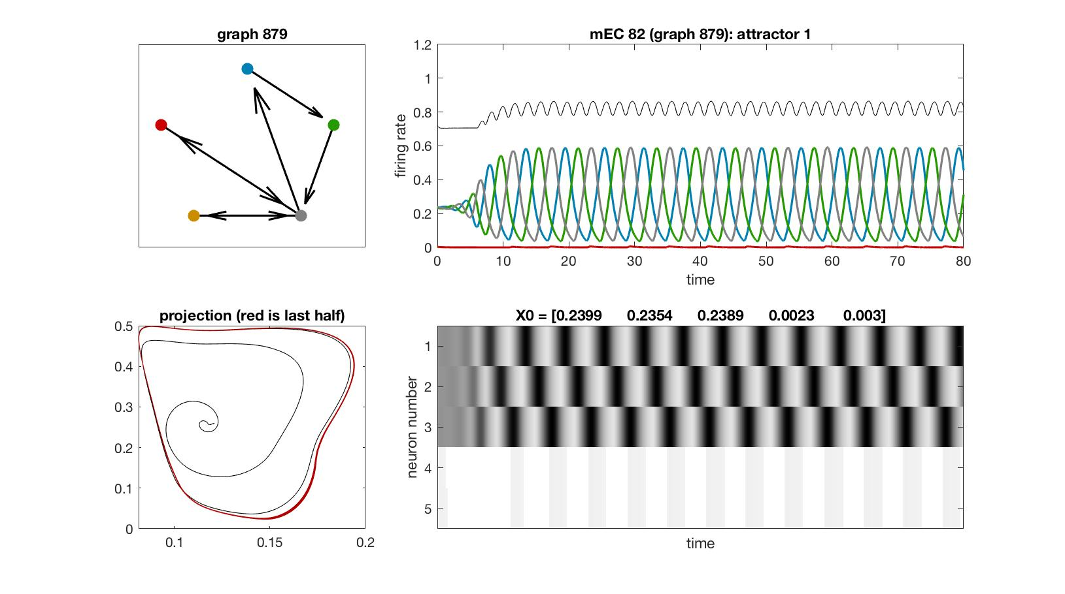
mEC 82

Slide 10

mEC 83

Slide 11
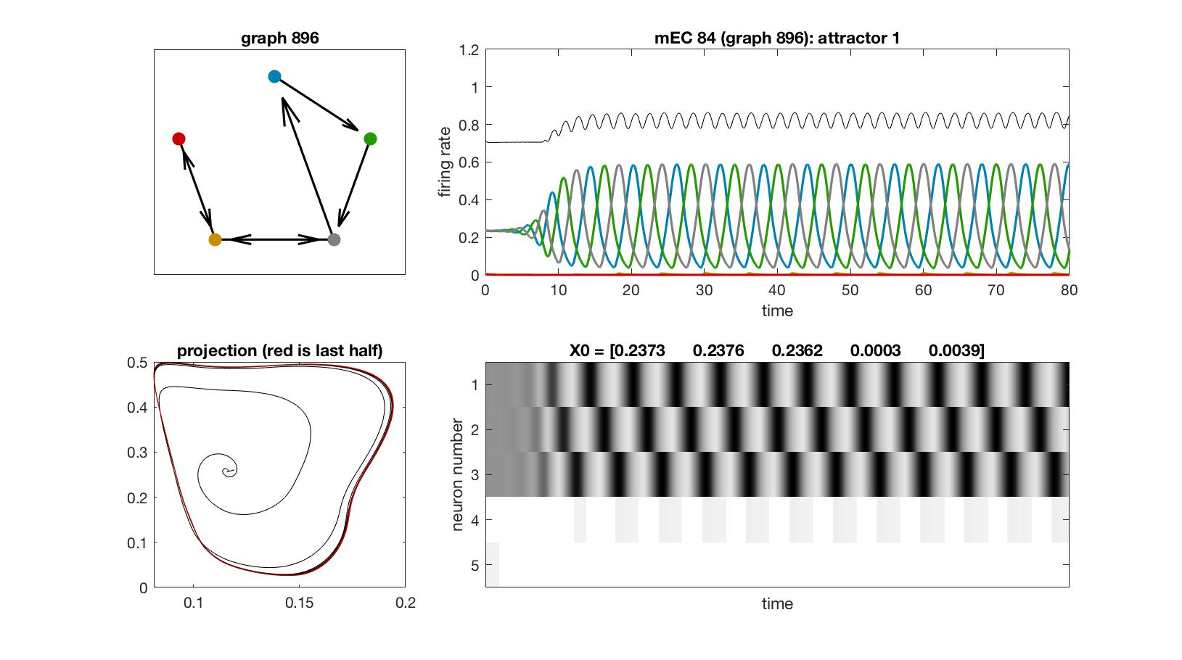
mEC 84

Slide 12

mEC 85

Slide 13
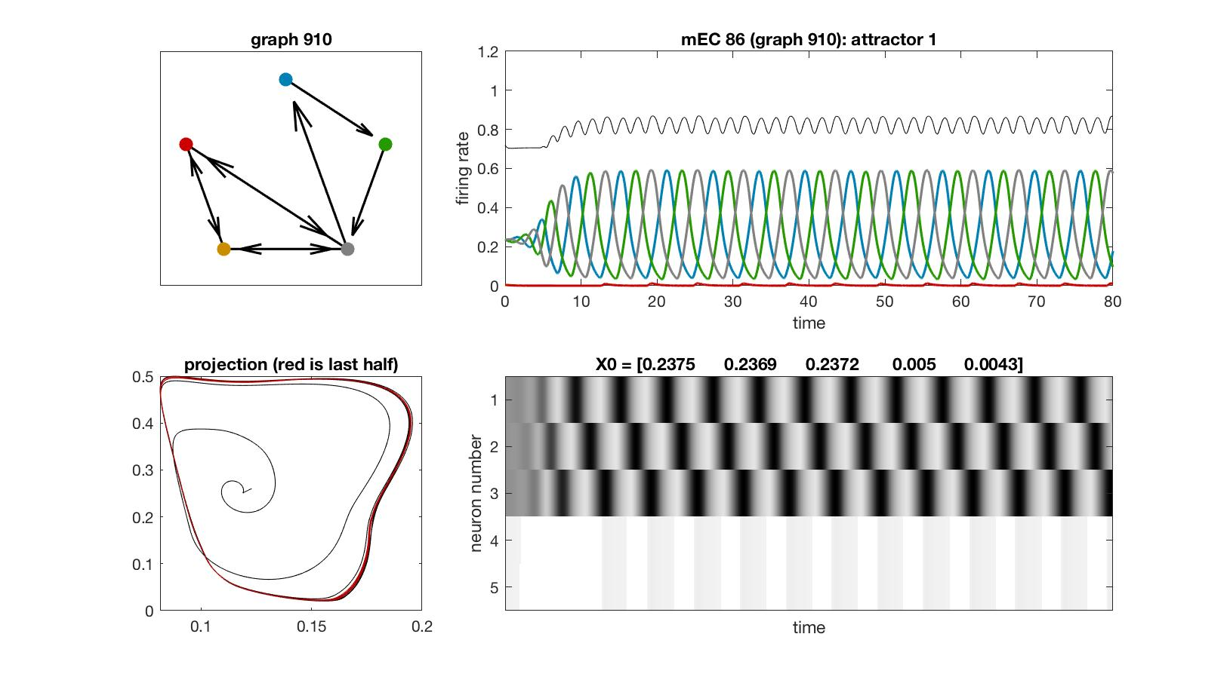
mEC 86

Slide 14
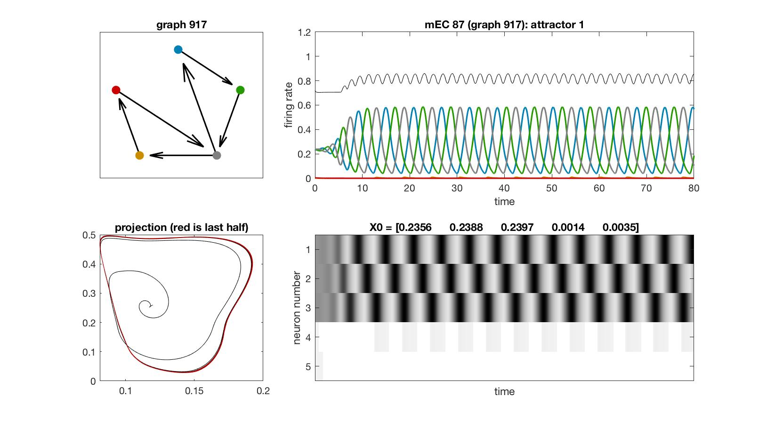
mEC 87

Slide 15
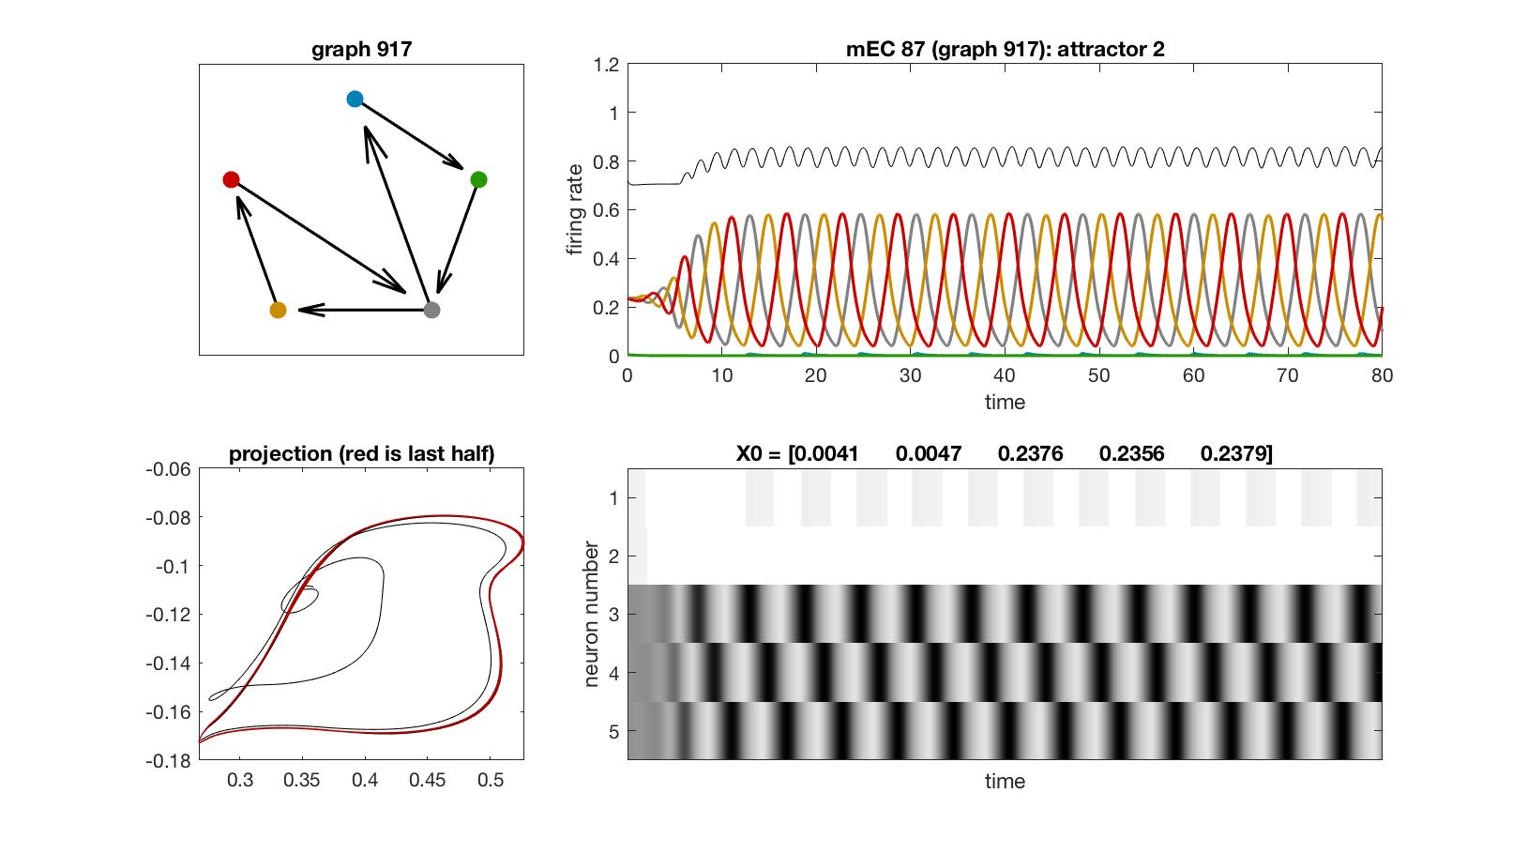
mEC 87

Slide 16

mEC 88

Slide 17
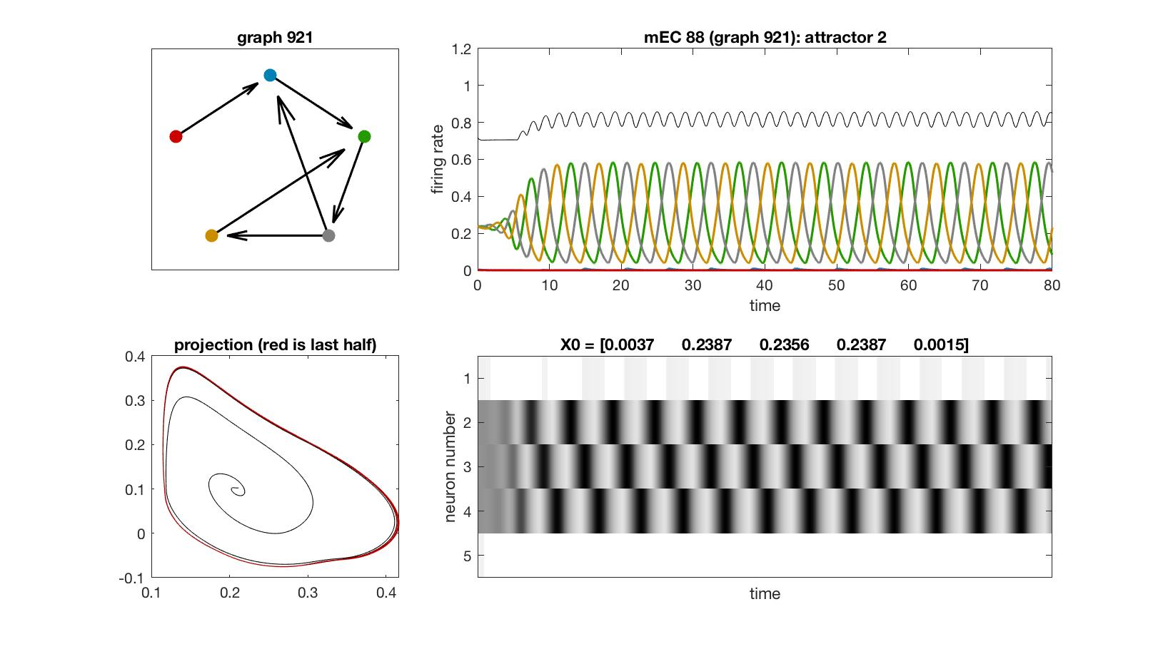
mEC 88

Slide 18
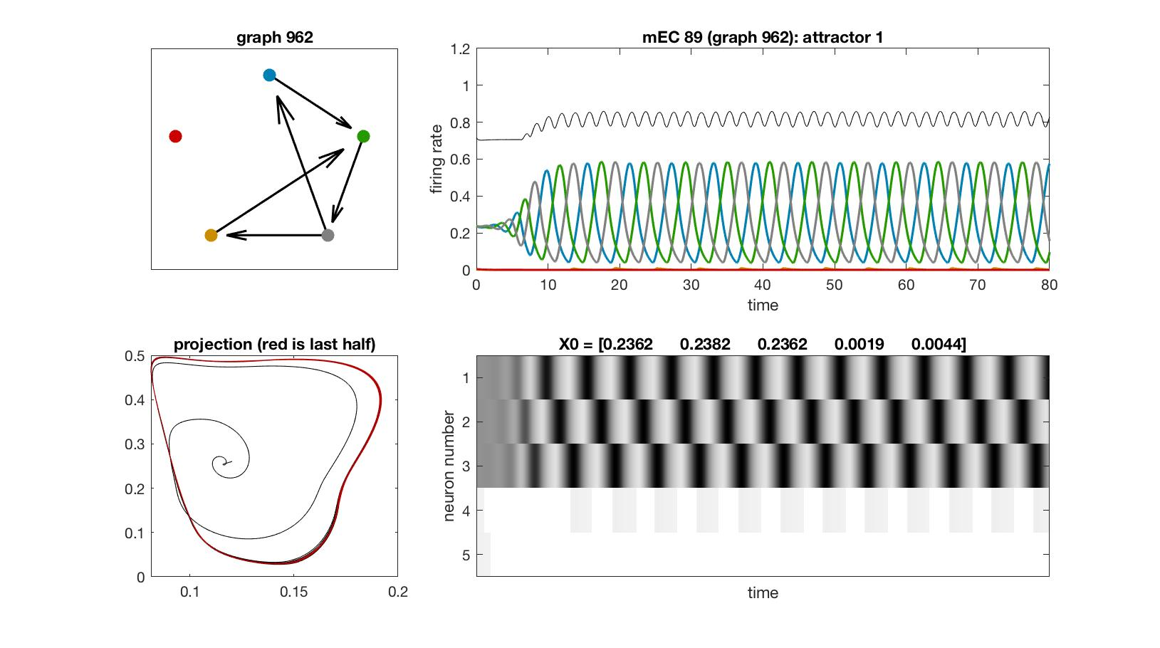
mEC 89

Slide 19
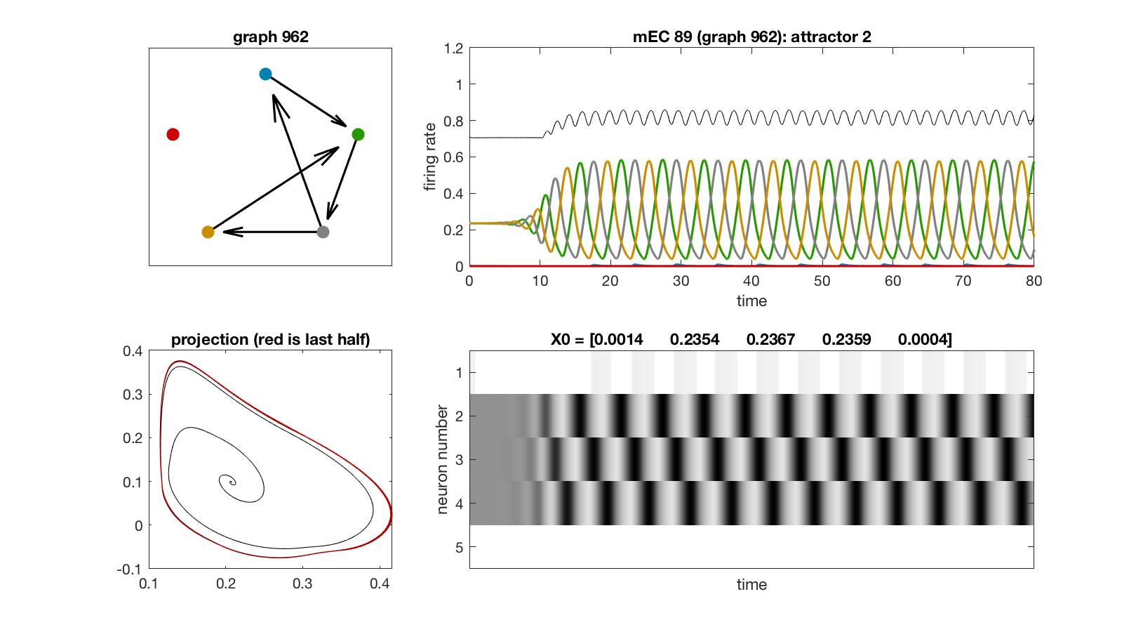
mEC 89

Slide 20

mEC 90

Slide 21

mEC 90

Slide 22

mEC 91

Slide 23
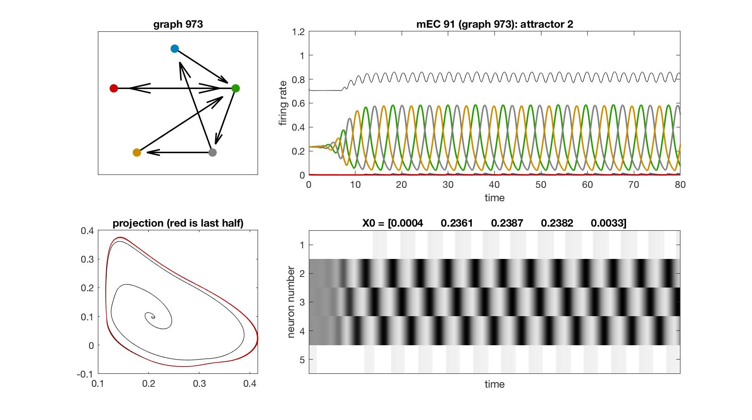
mEC 91

Slide 24
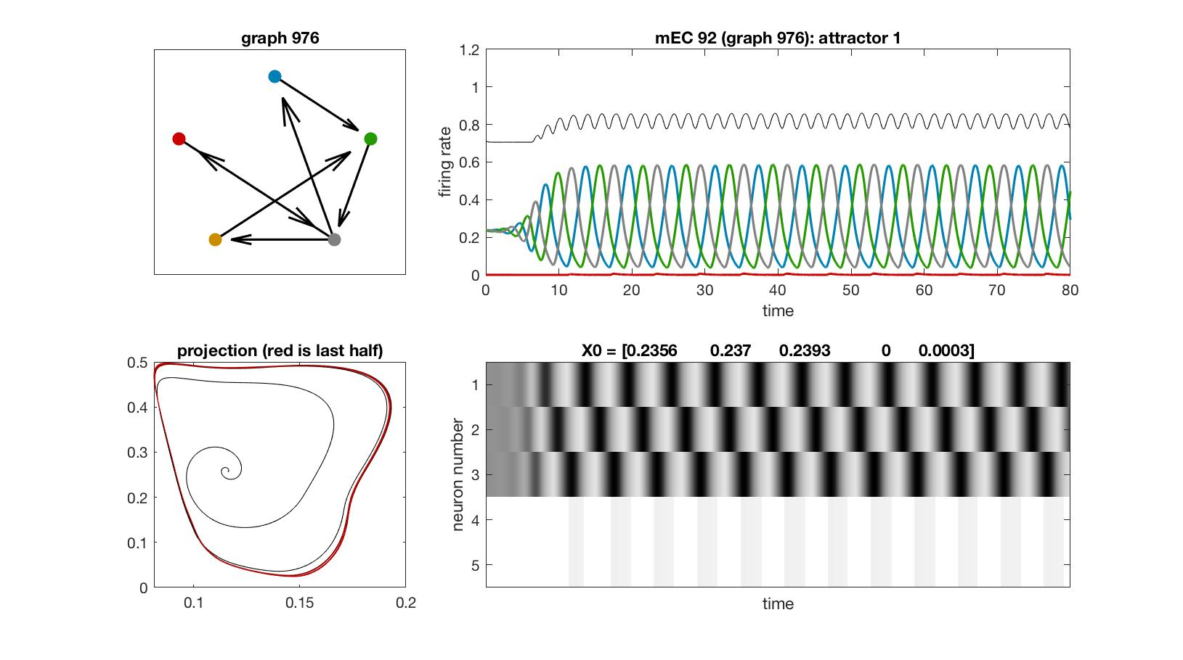
mEC 92

Slide 25
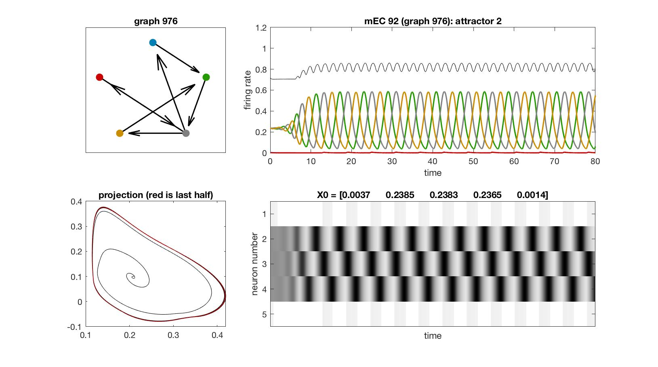
mEC 92

Slide 26

mEC 93

Slide 27
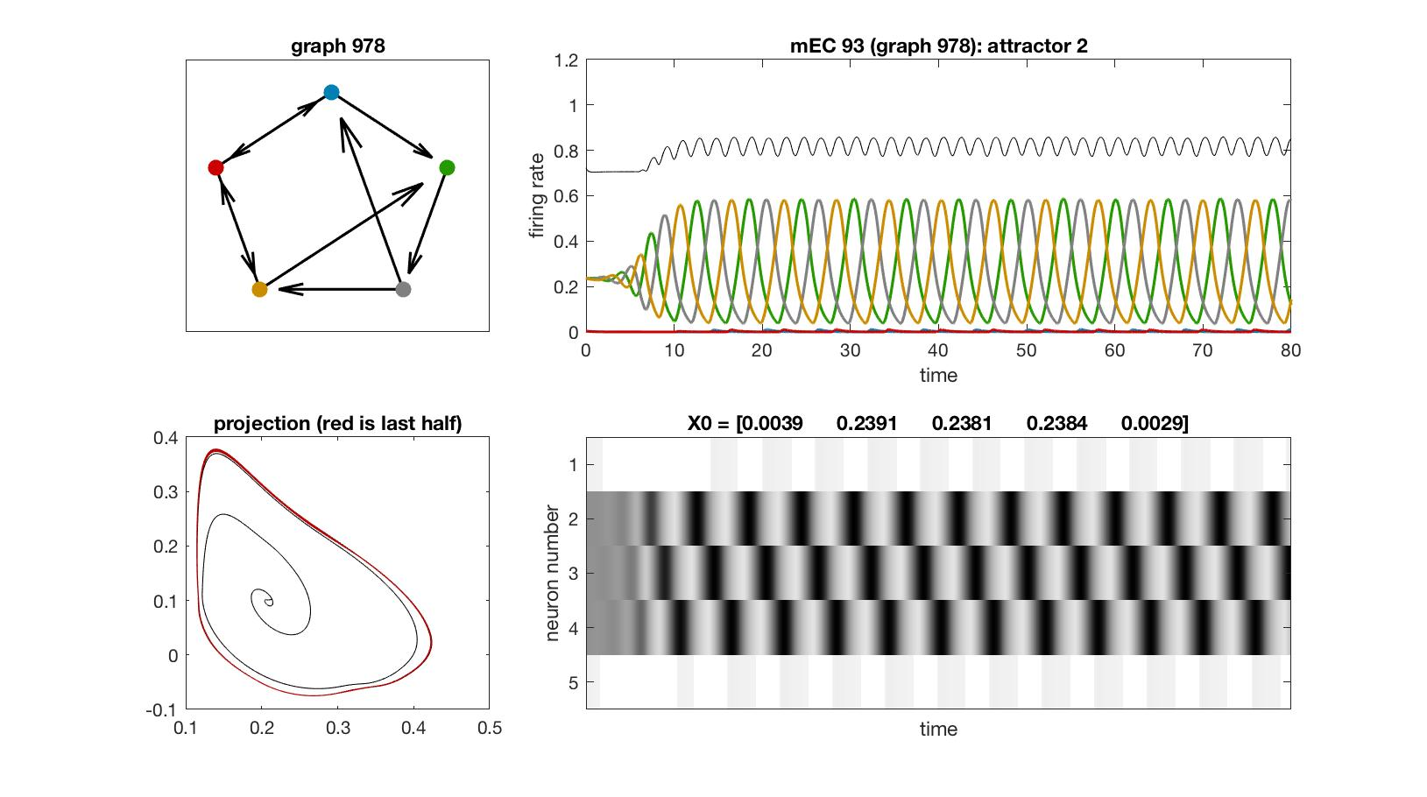
mEC 93

Slide 28

mEC 94

Slide 29
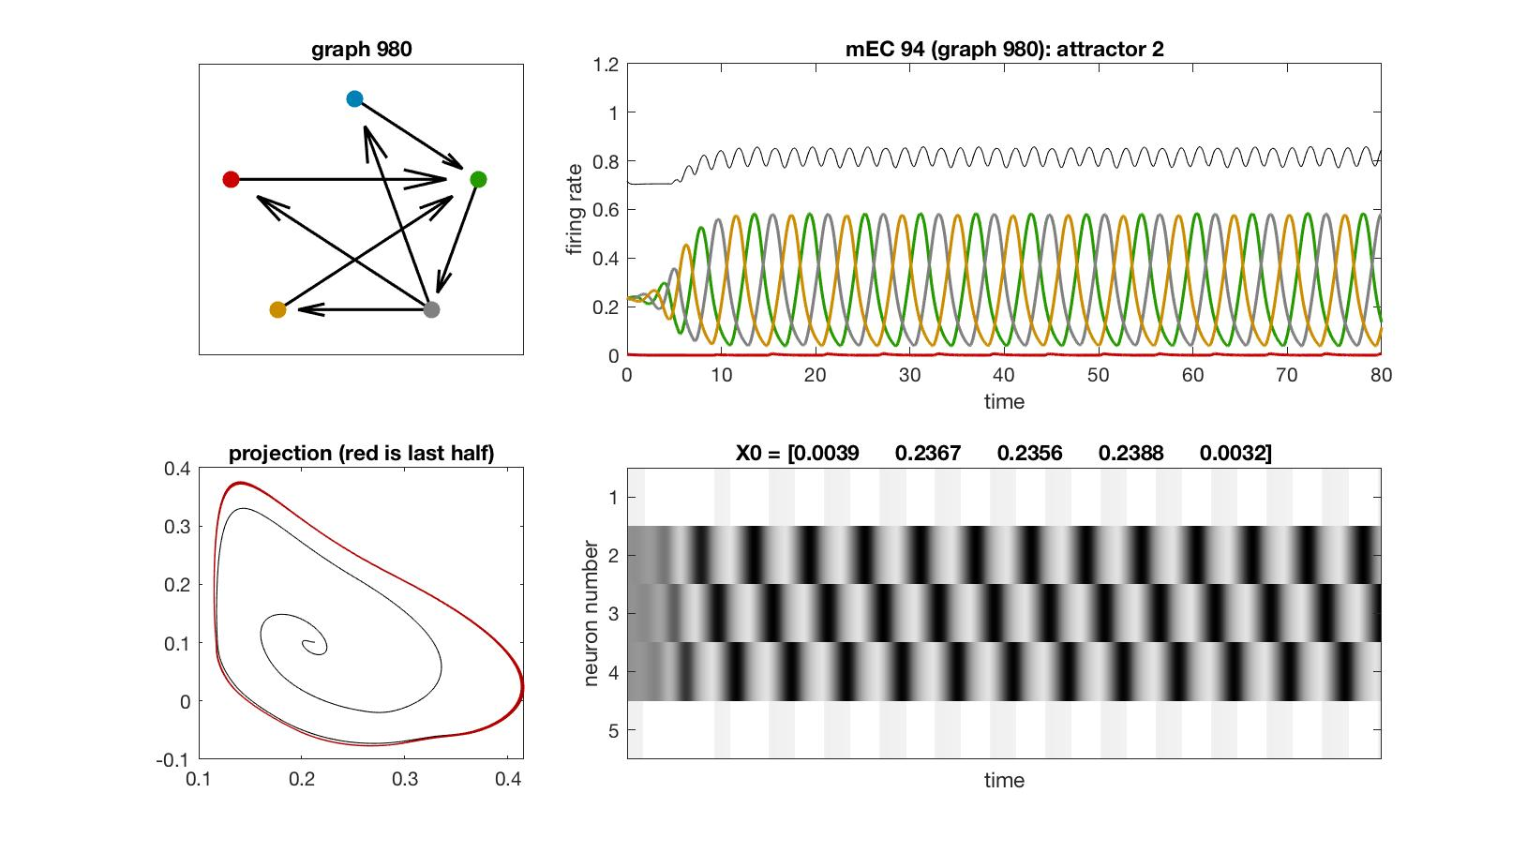
mEC 94

Slide 30
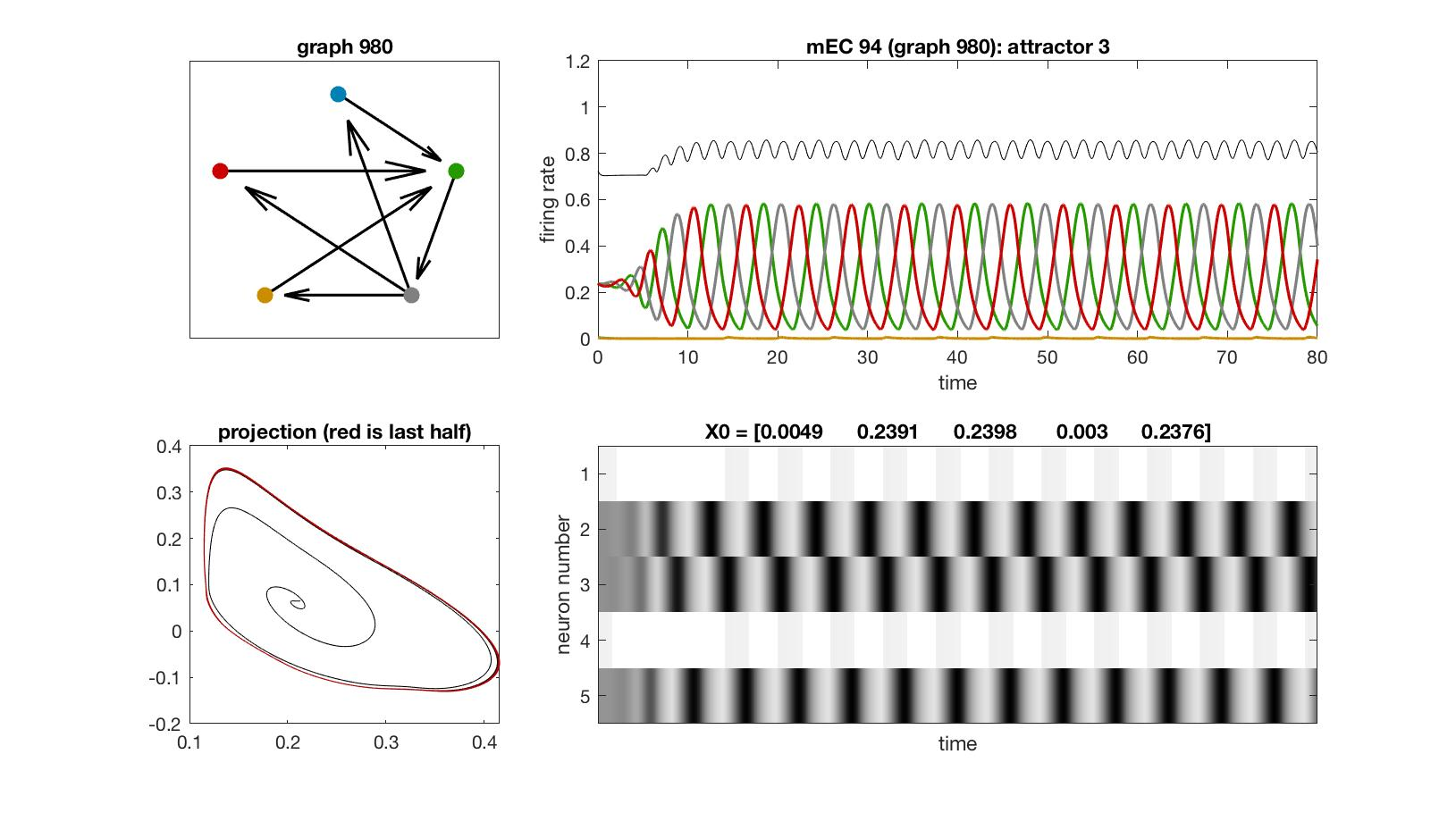
mEC 94

Slide 31

mEC 95

Slide 32
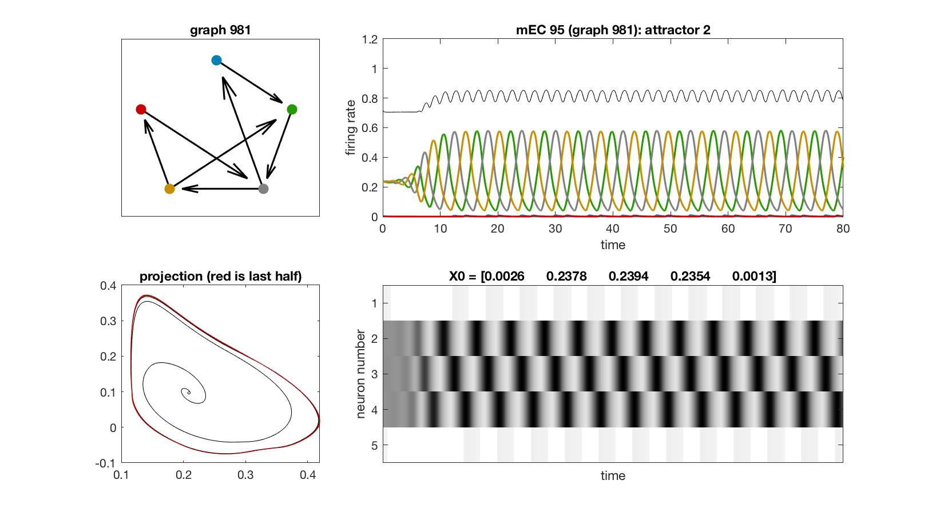
mEC 95

Slide 33
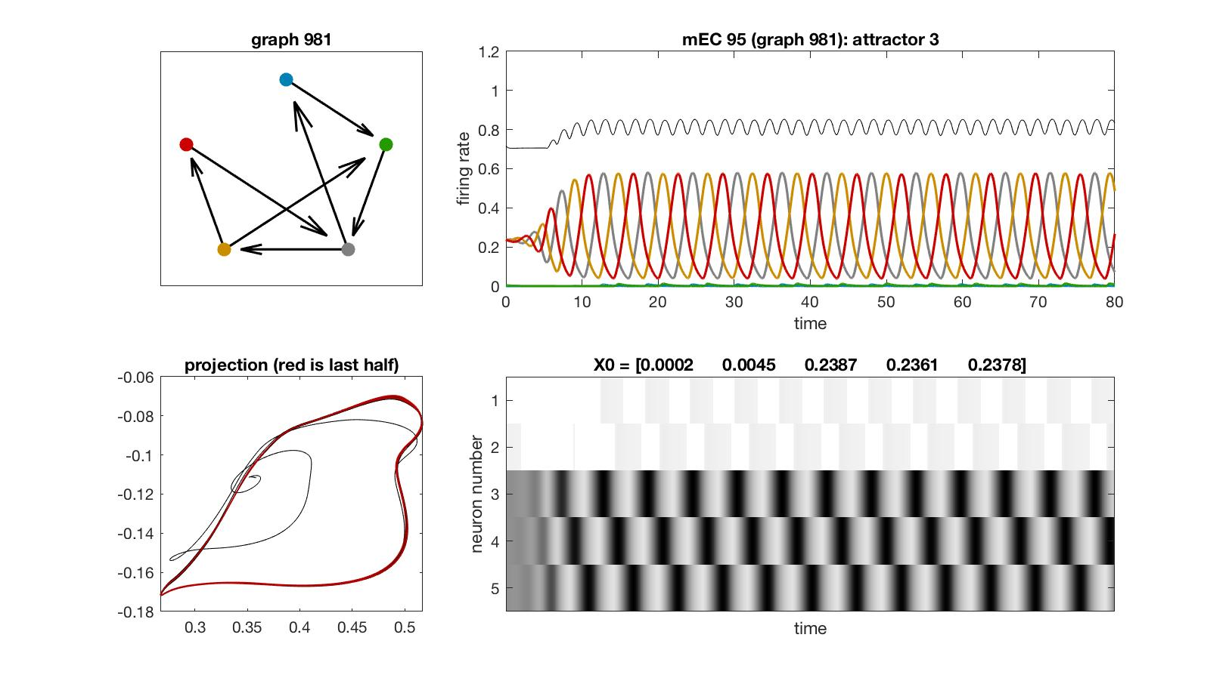
mEC 95

Slide 34
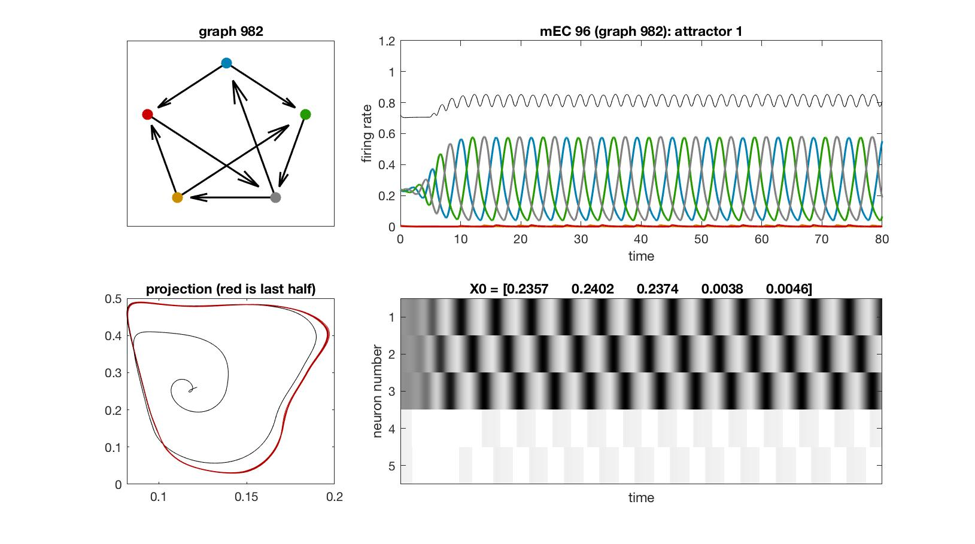
mEC 96

Slide 35
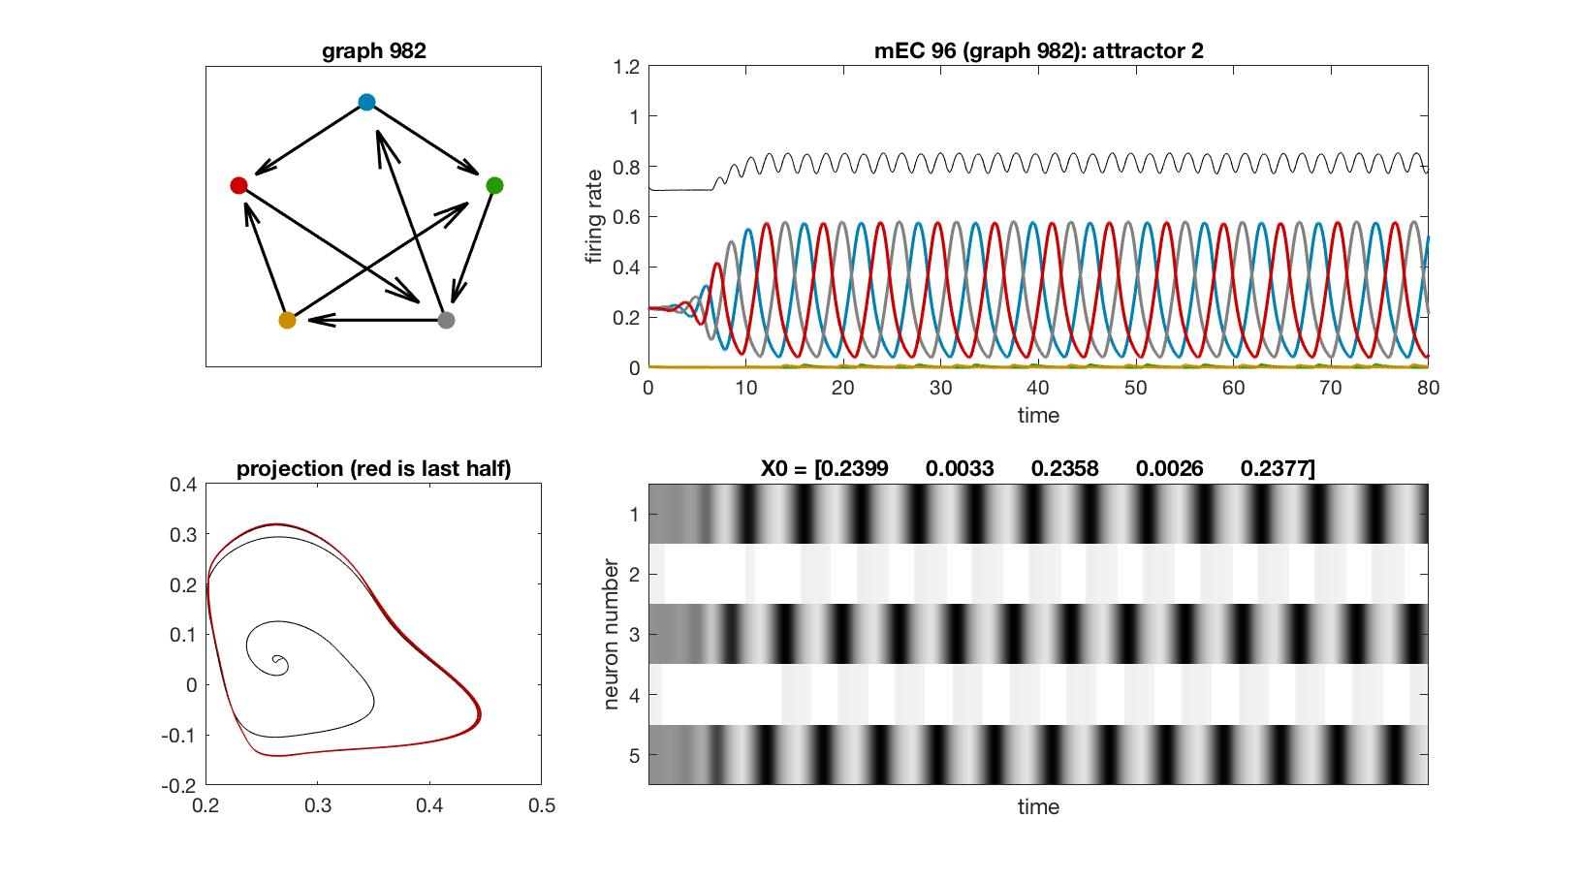
mEC 96

Slide 36
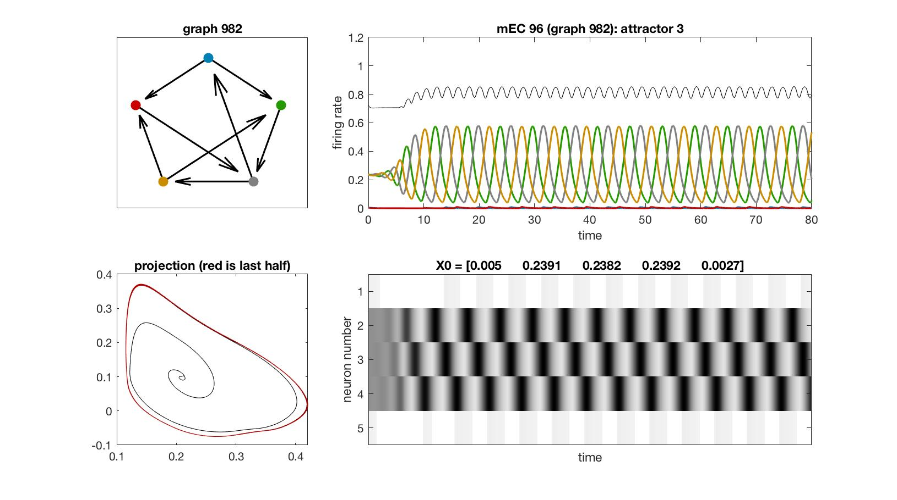
mEC 96

Slide 37
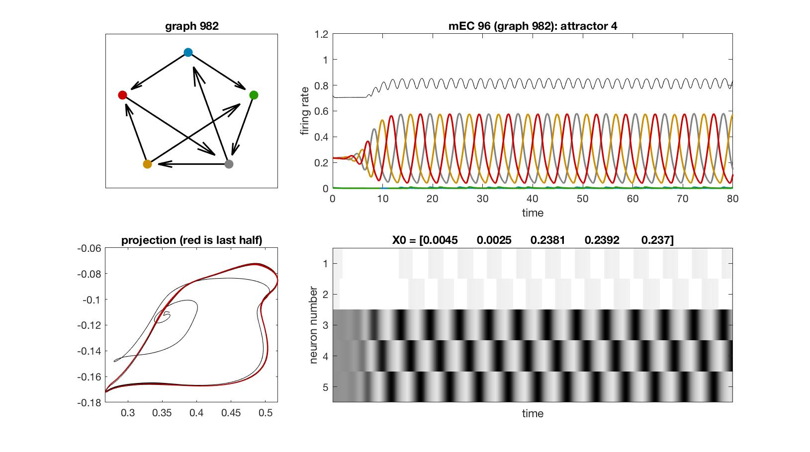
mEC 96

Slide 38
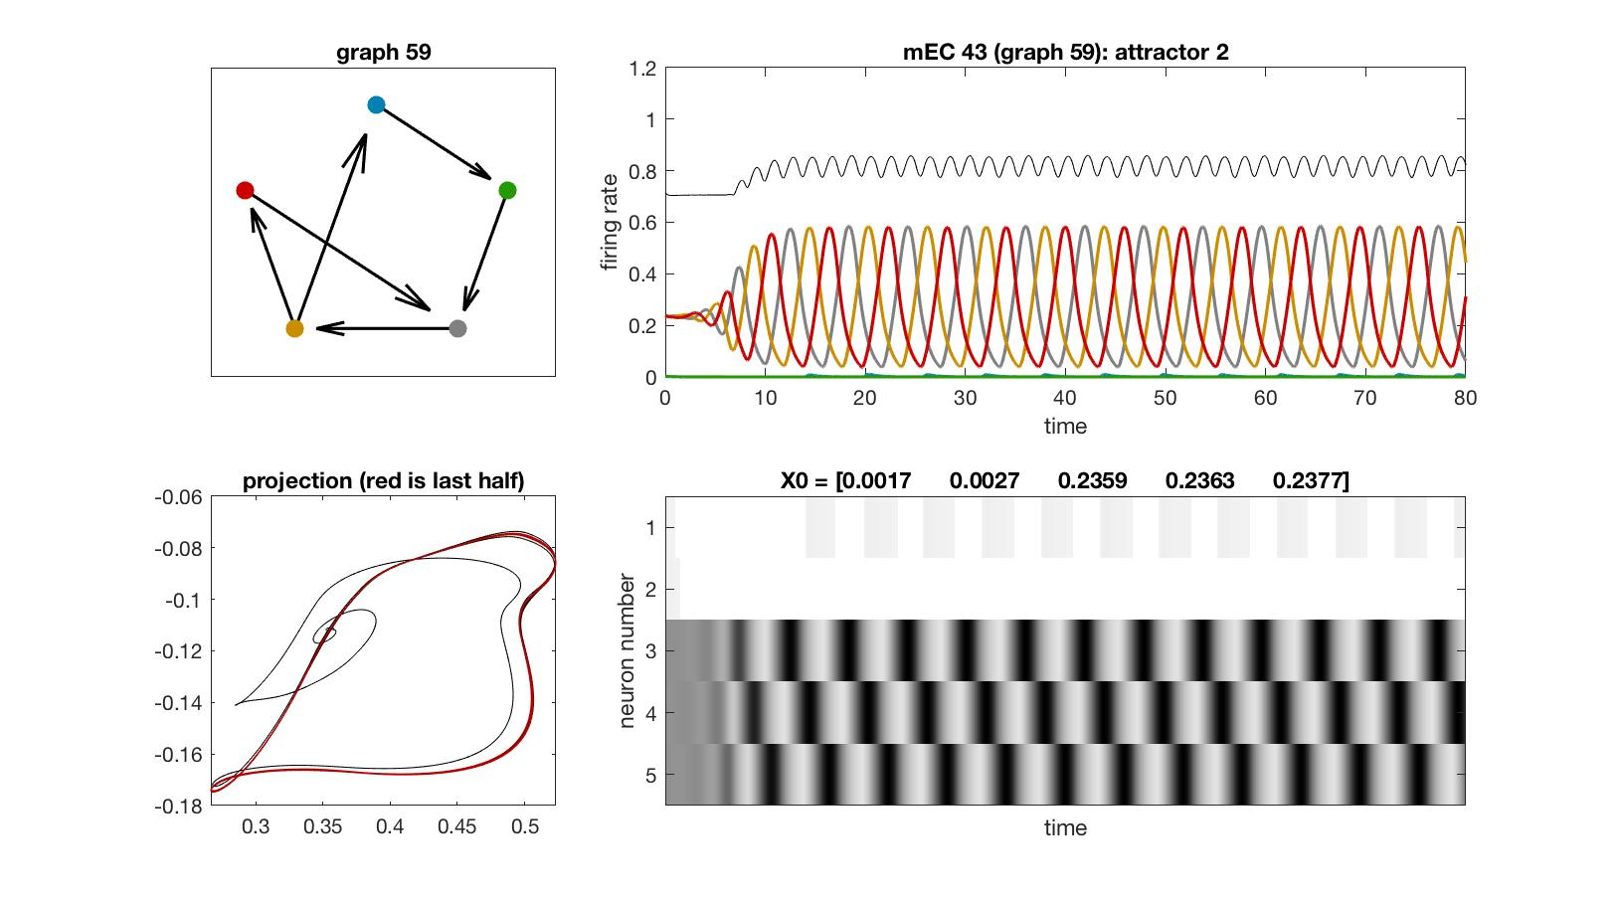
mEC 43

Slide 39
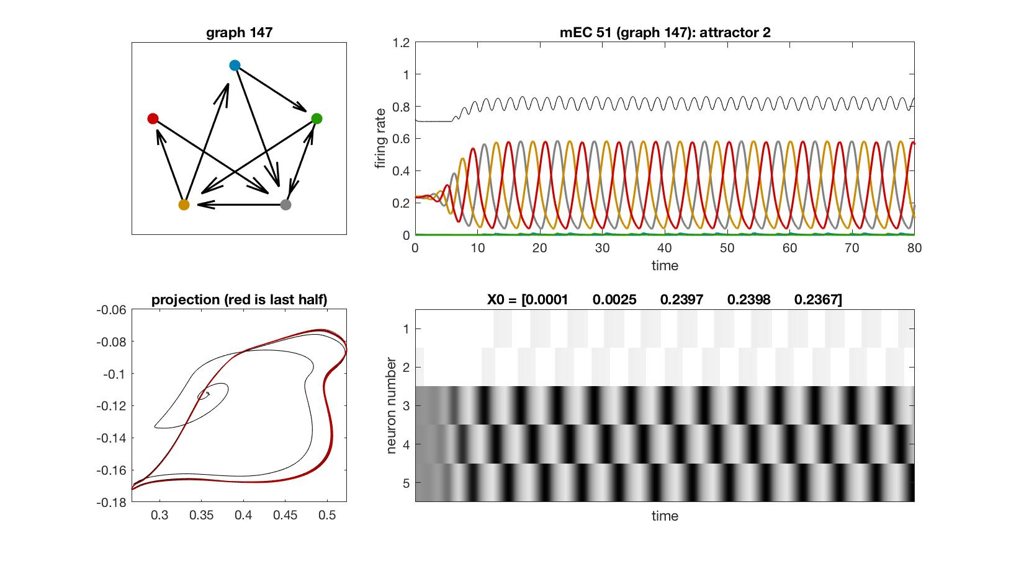
mEC 51

Slide 40
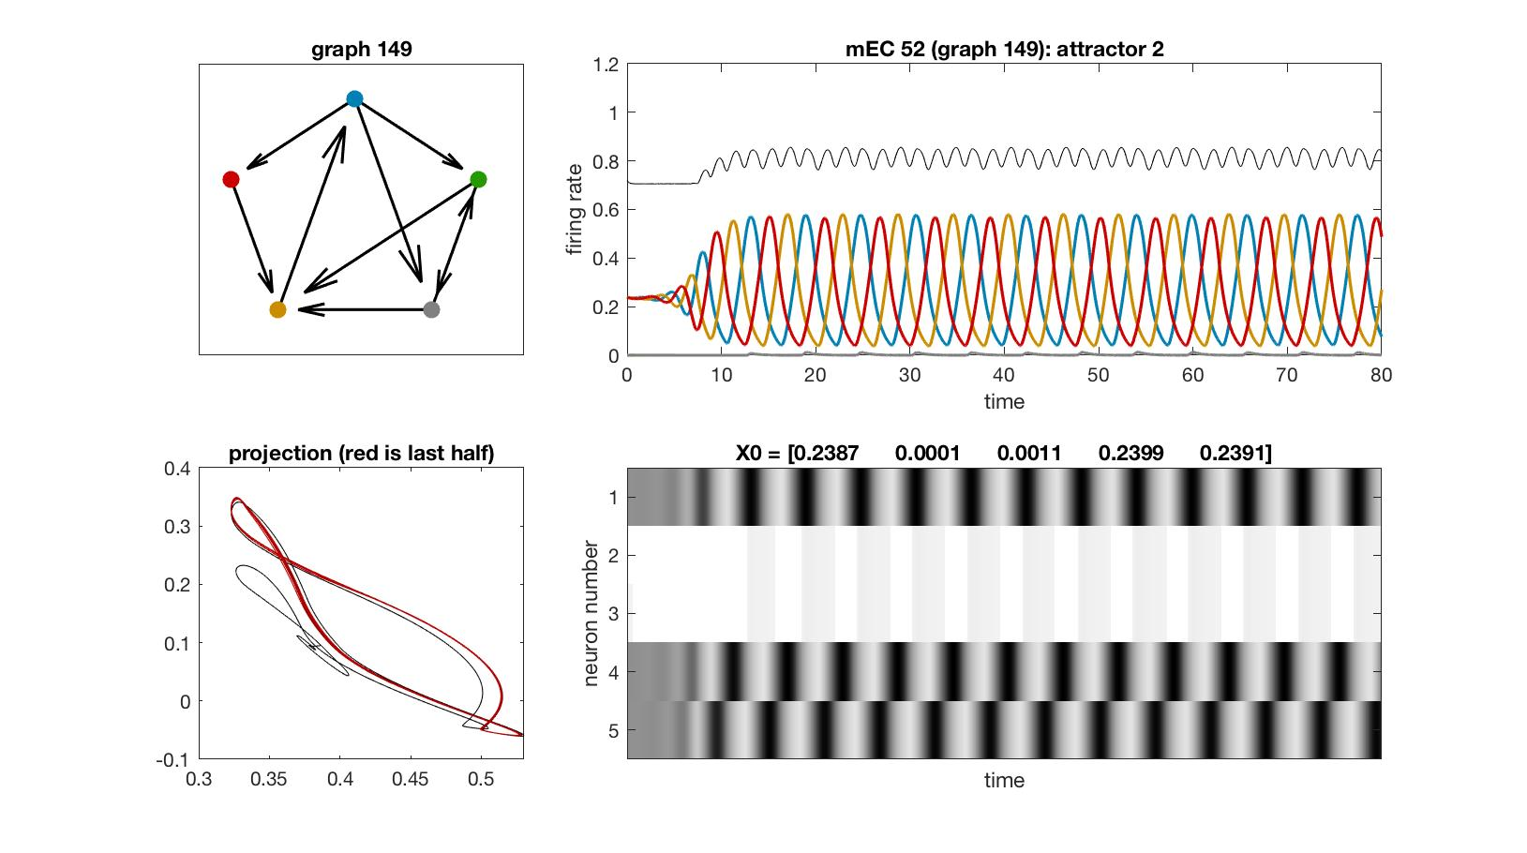
mEC 52

Slide 41

mEC 64

Slide 42
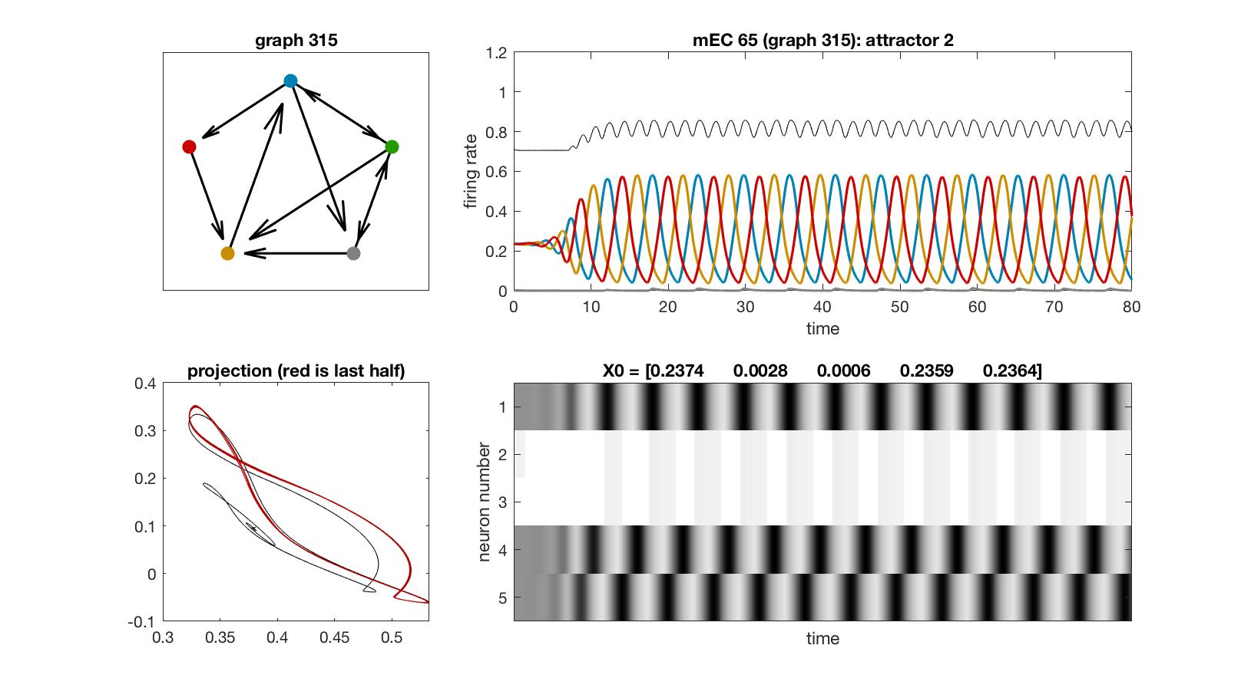
mEC 65

Slide 43
4-cycle

Slide 44
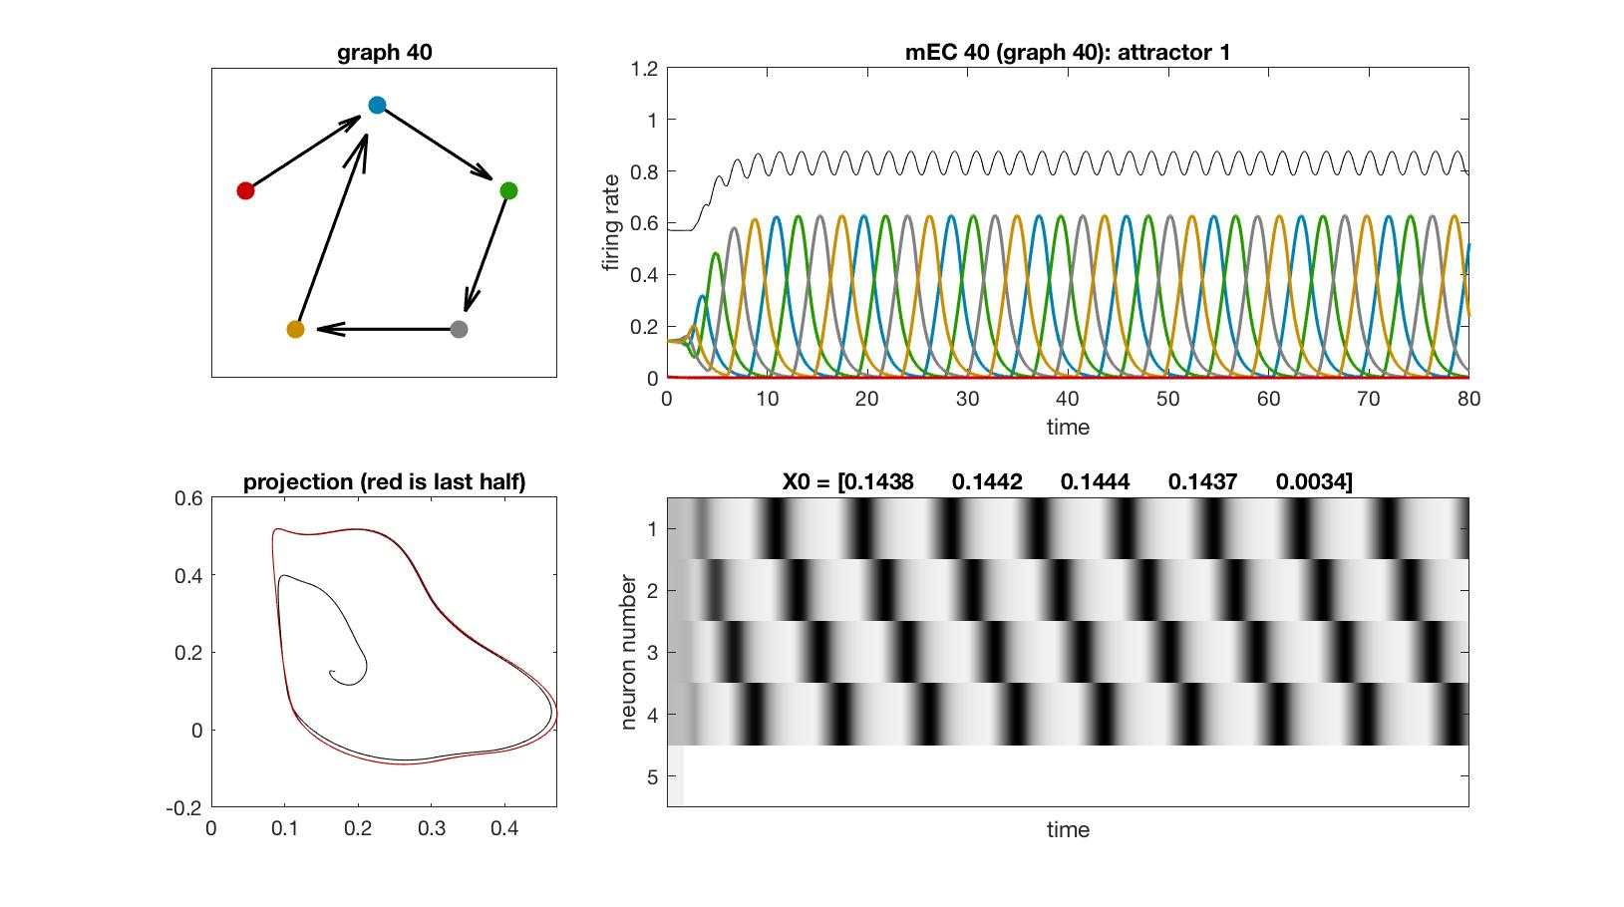
mEC 40

Slide 45
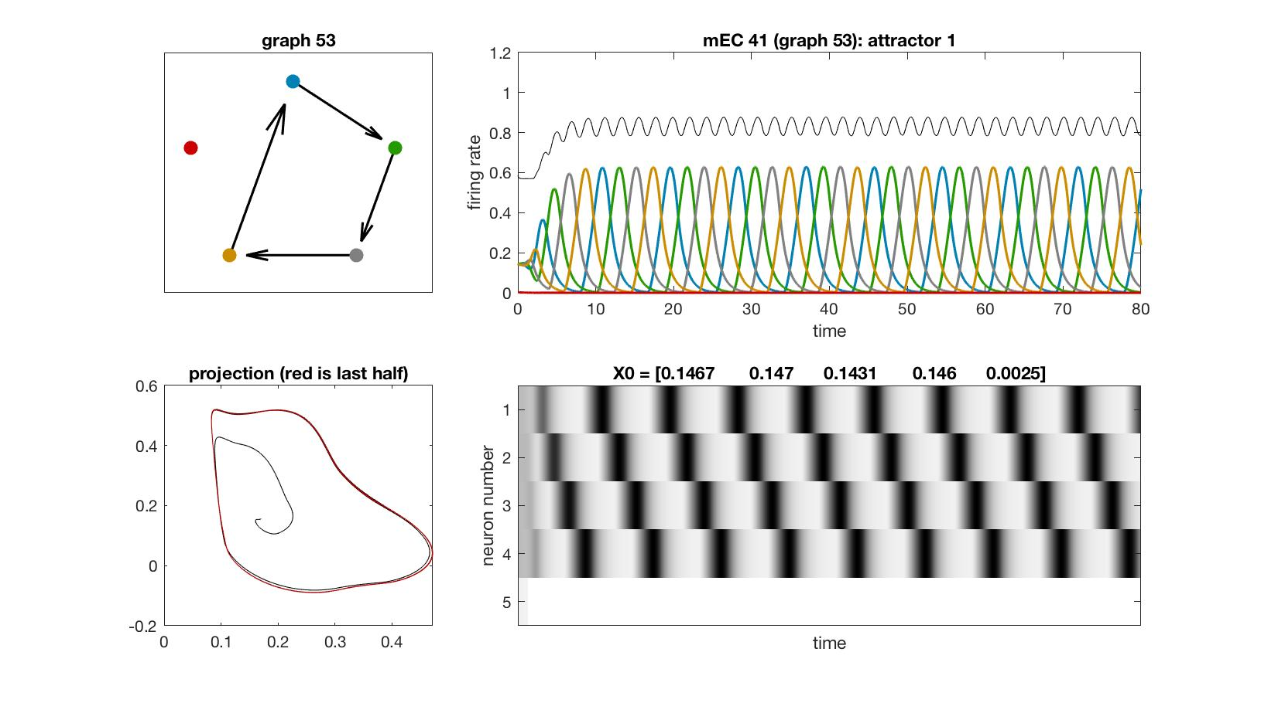
mEC 41

Slide 46
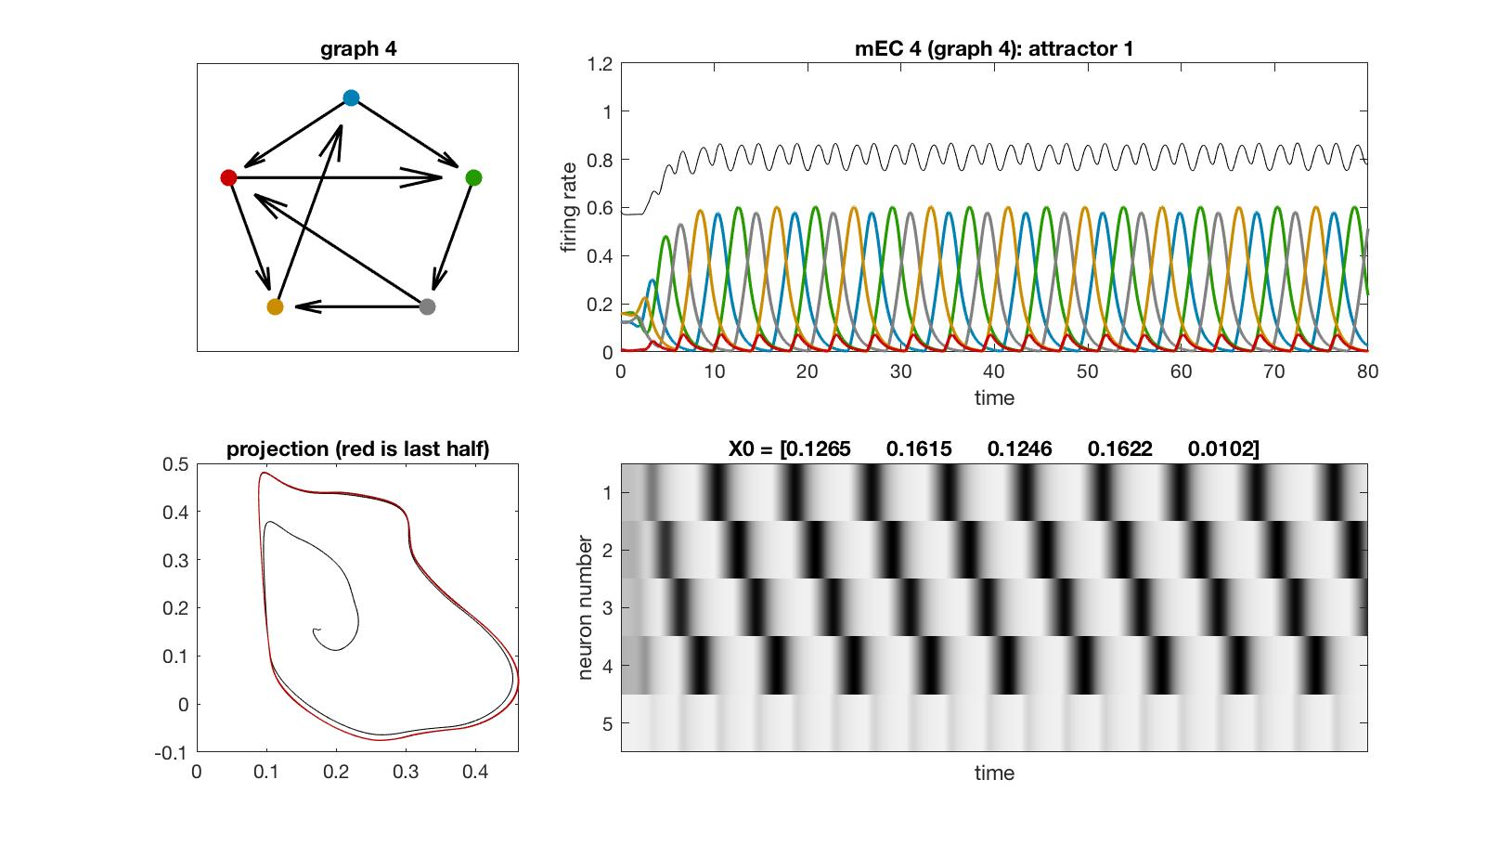
mEC 4

Slide 47
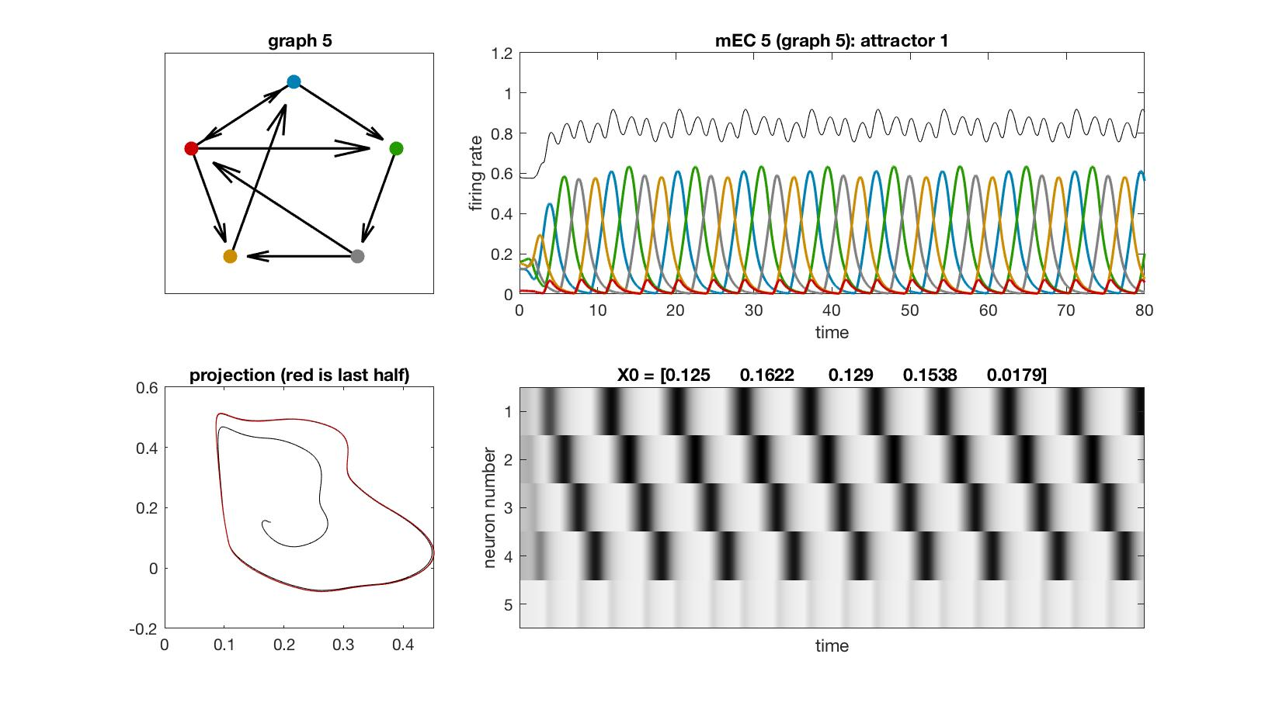
mEC 5

Slide 48

mEC 6

Slide 49
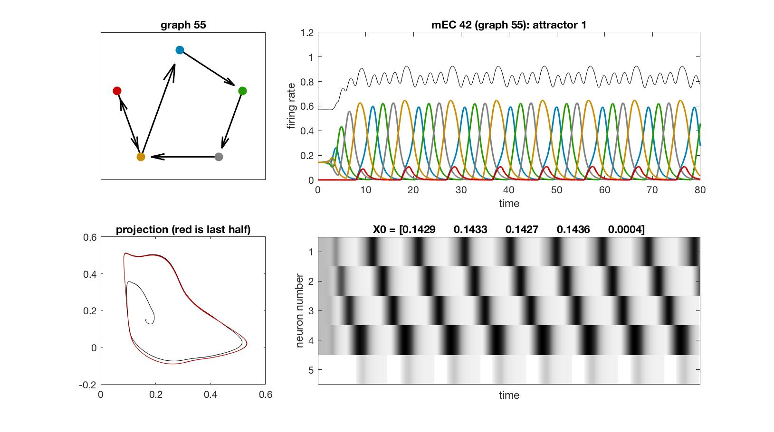
mEC 42

Slide 50
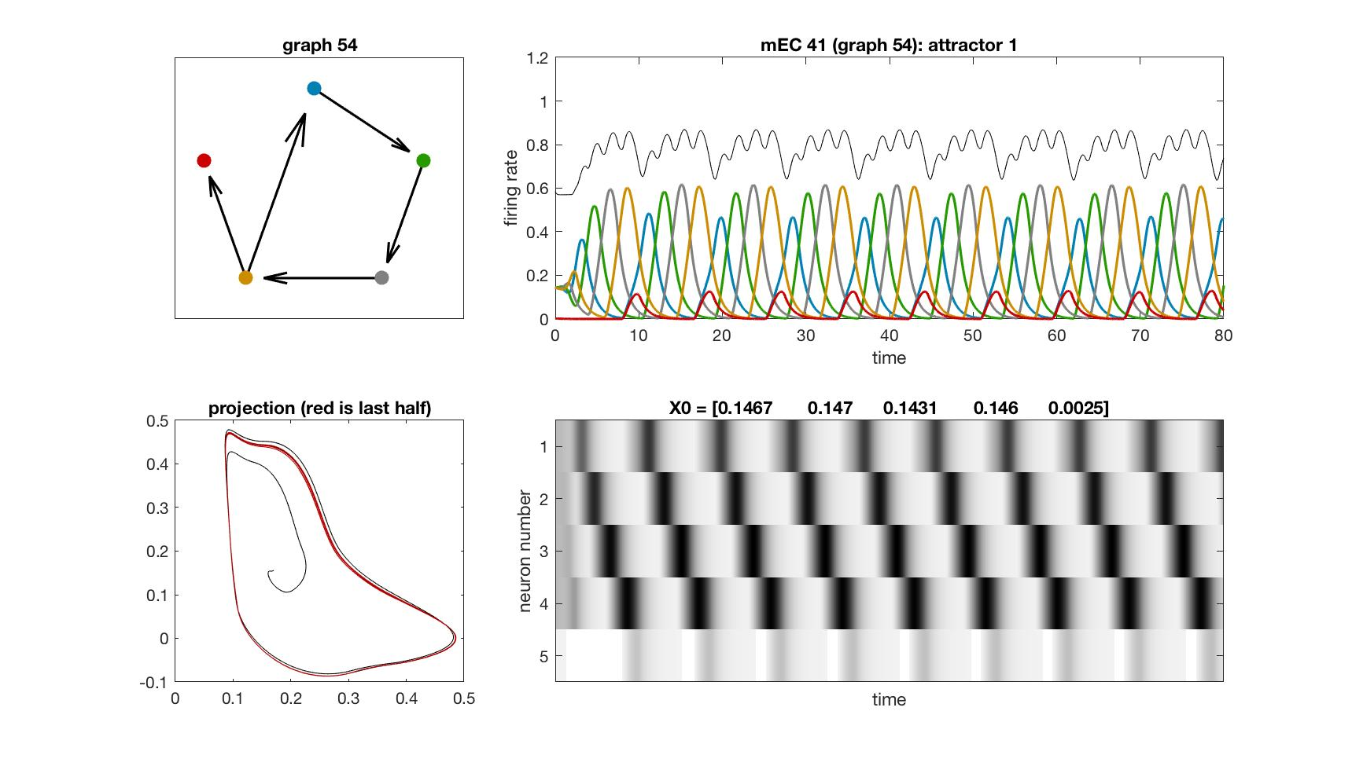
mEC 41

Slide 51
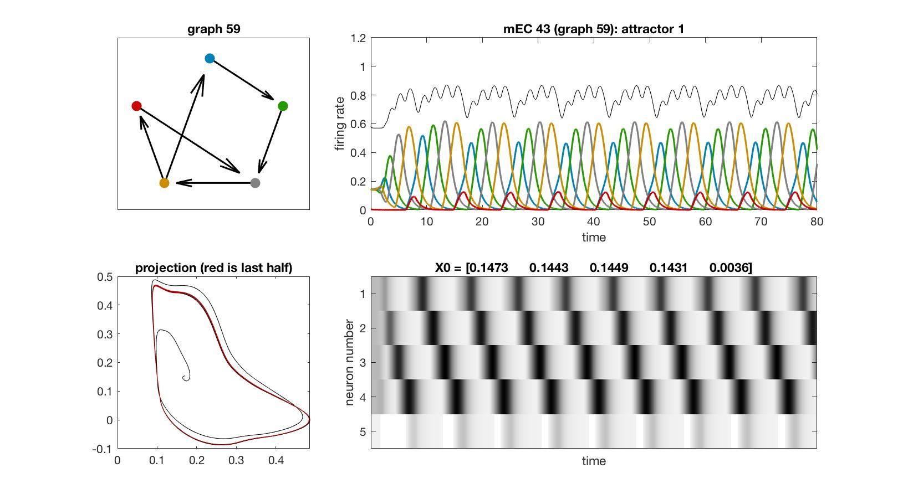
mEC 43

Slide 52
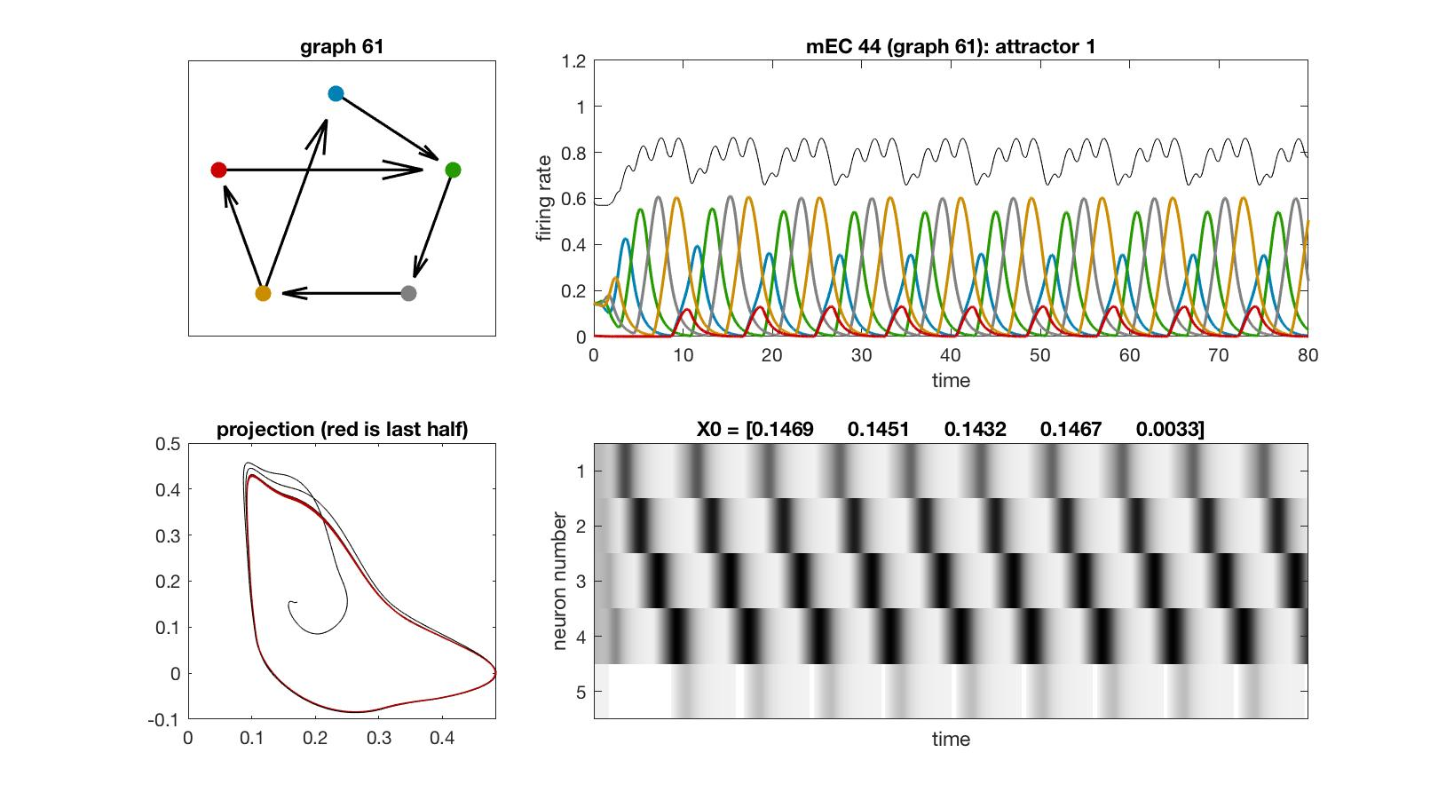
mEC 44

Slide 53
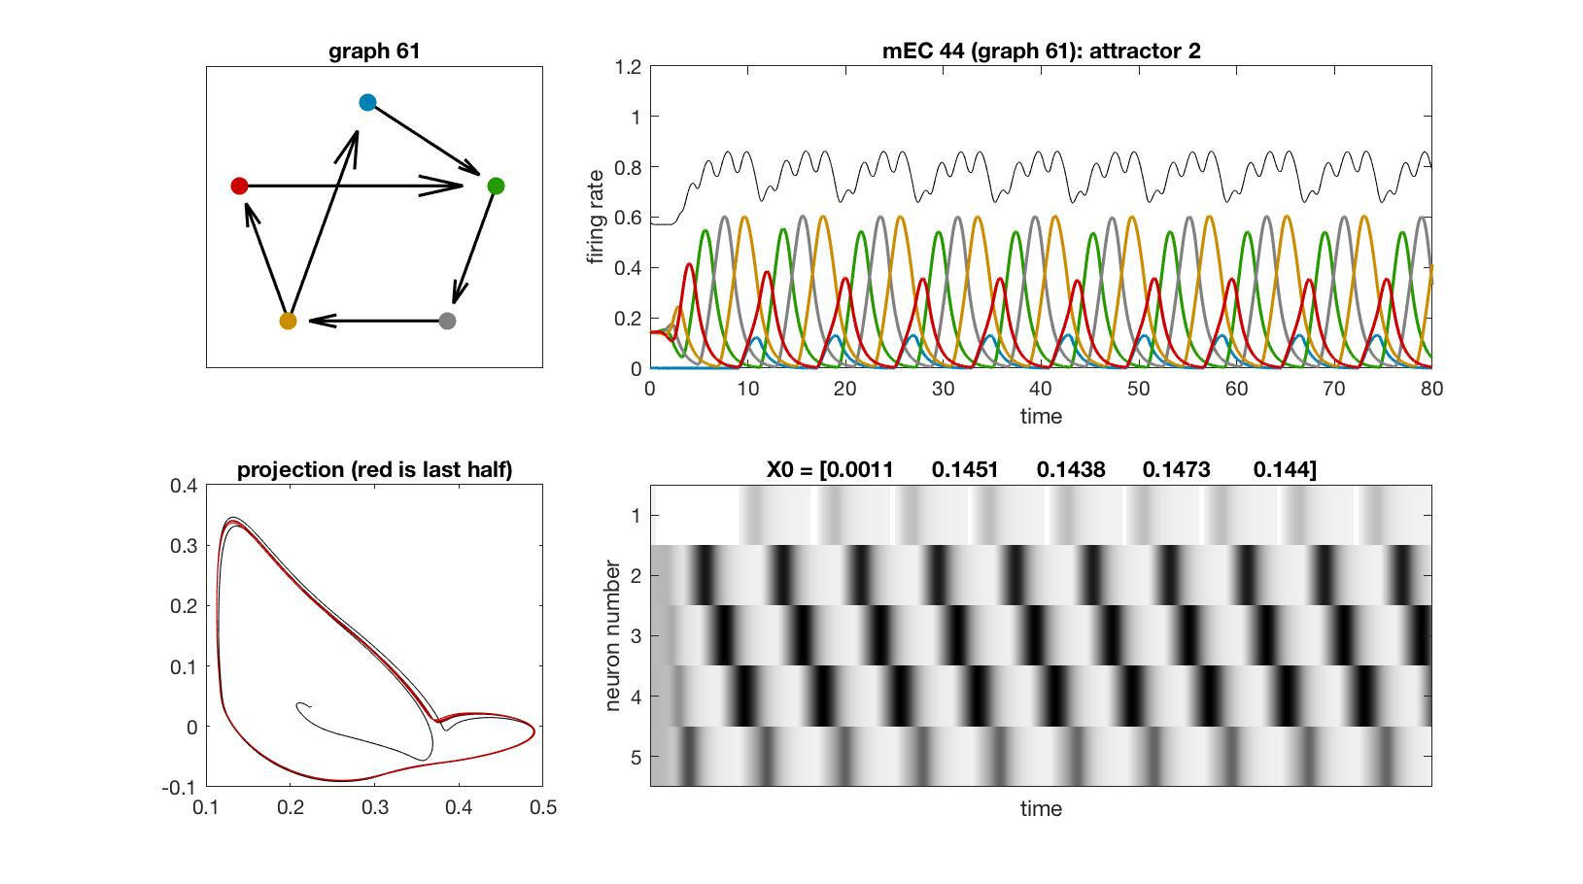
mEC 44

Slide 54
4-cycu

Slide 55
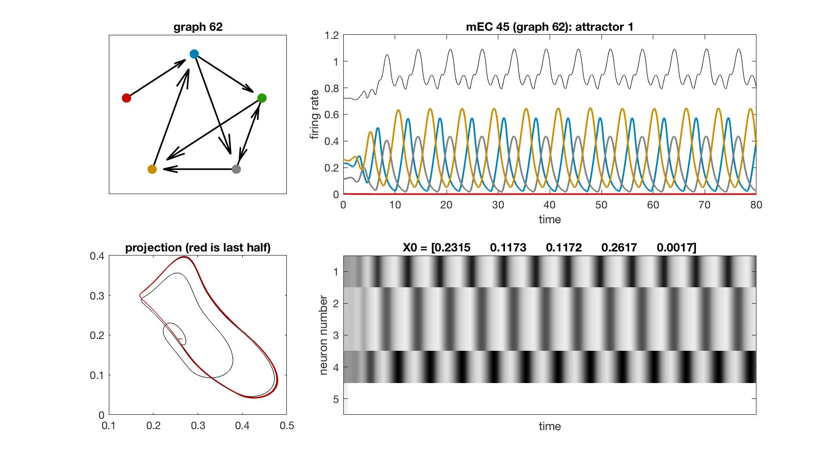
mEC 45

Slide 56
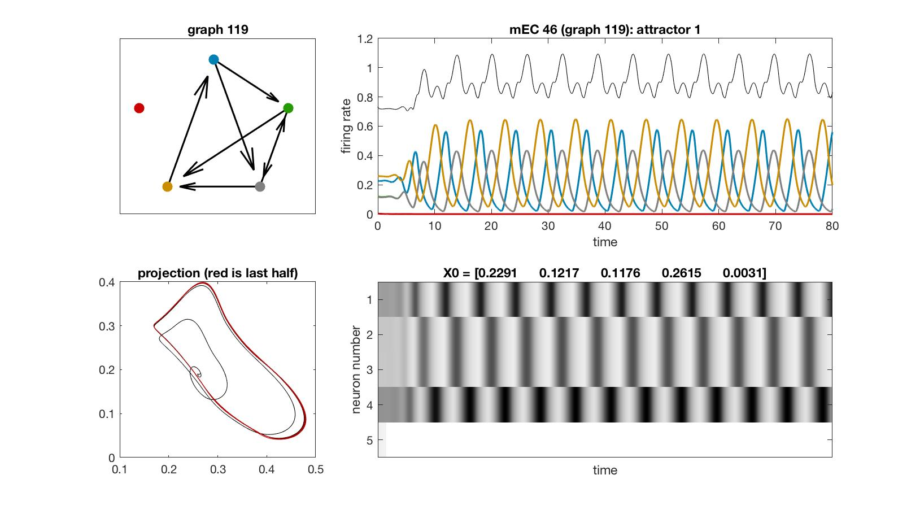
mEC 46

Slide 57
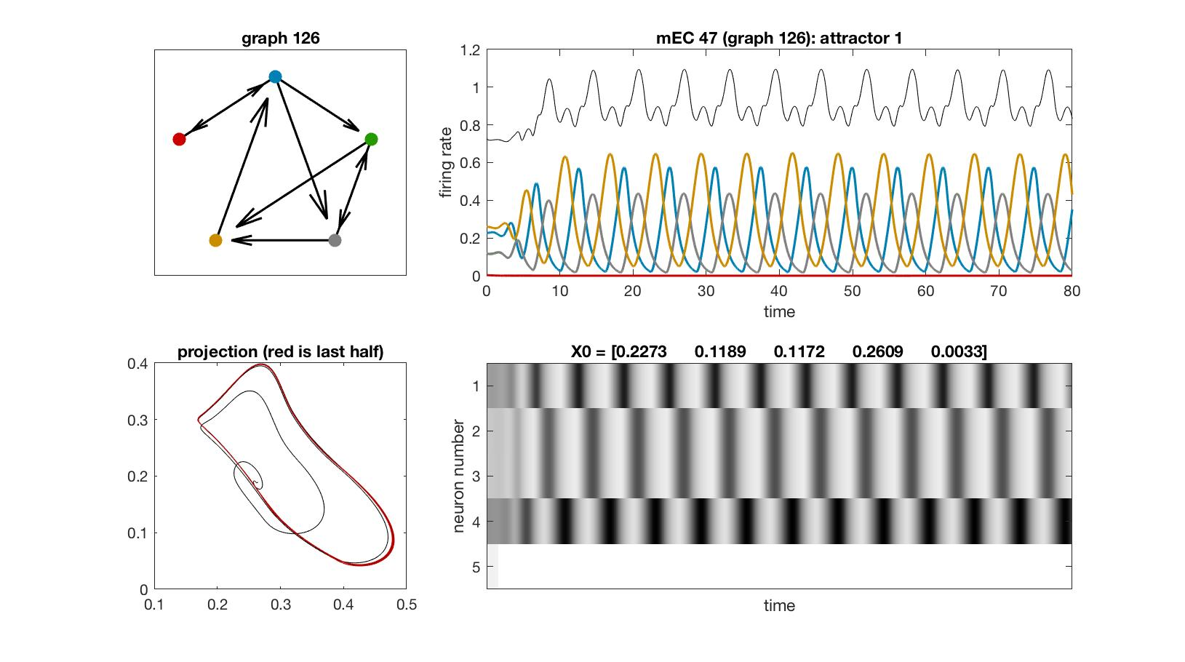
mEC 47

Slide 58
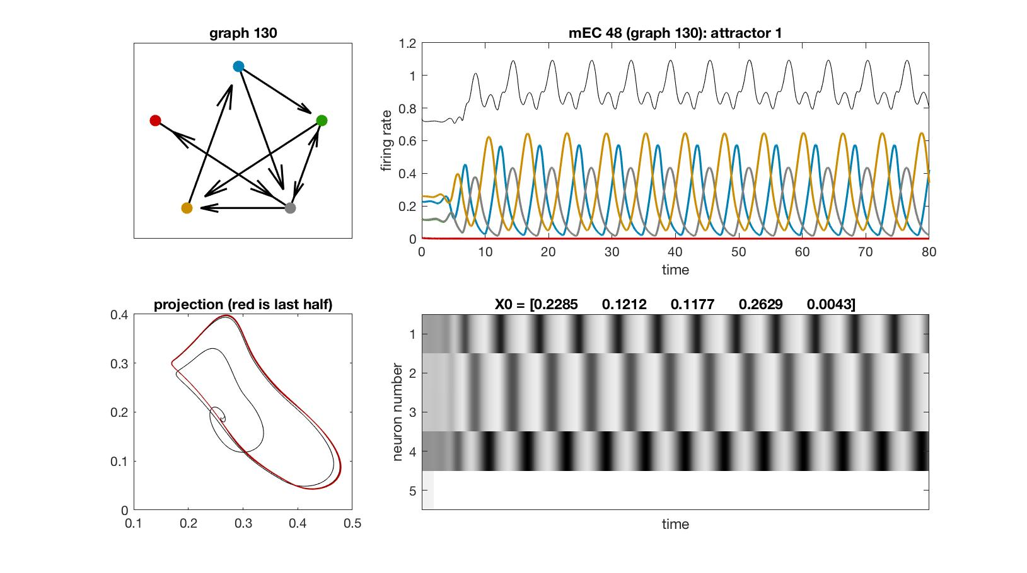
mEC 48

Slide 59
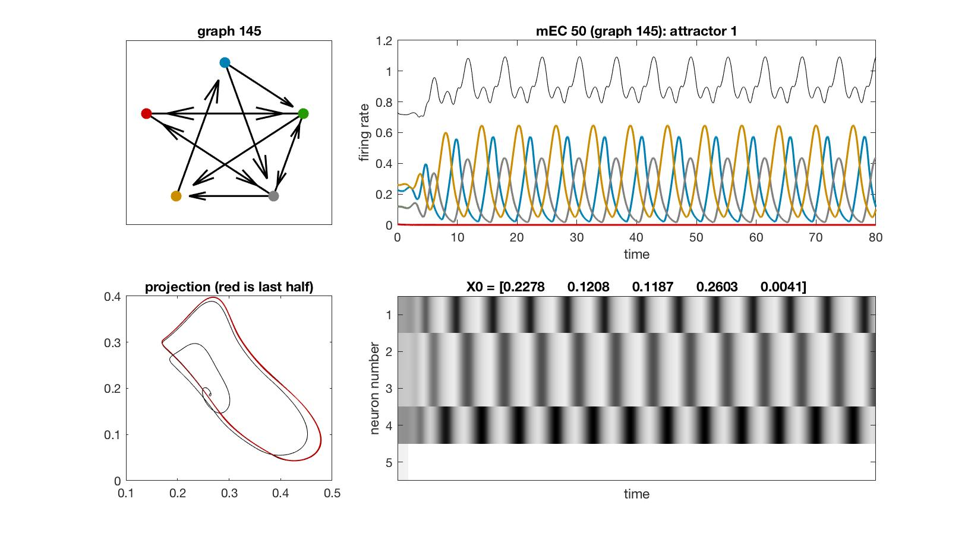
mEC 50

Slide 60

mEC 52

Slide 61
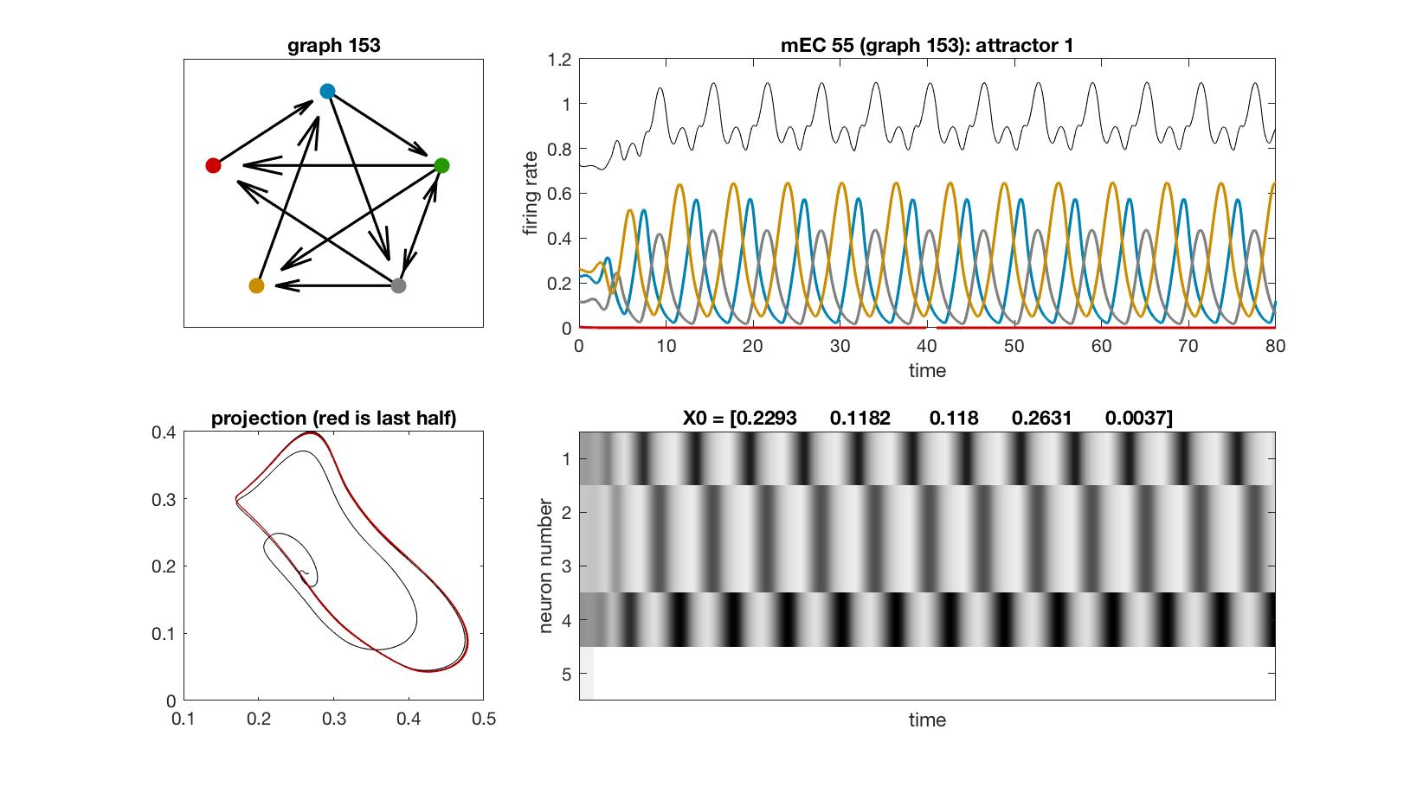
mEC 55

Slide 62
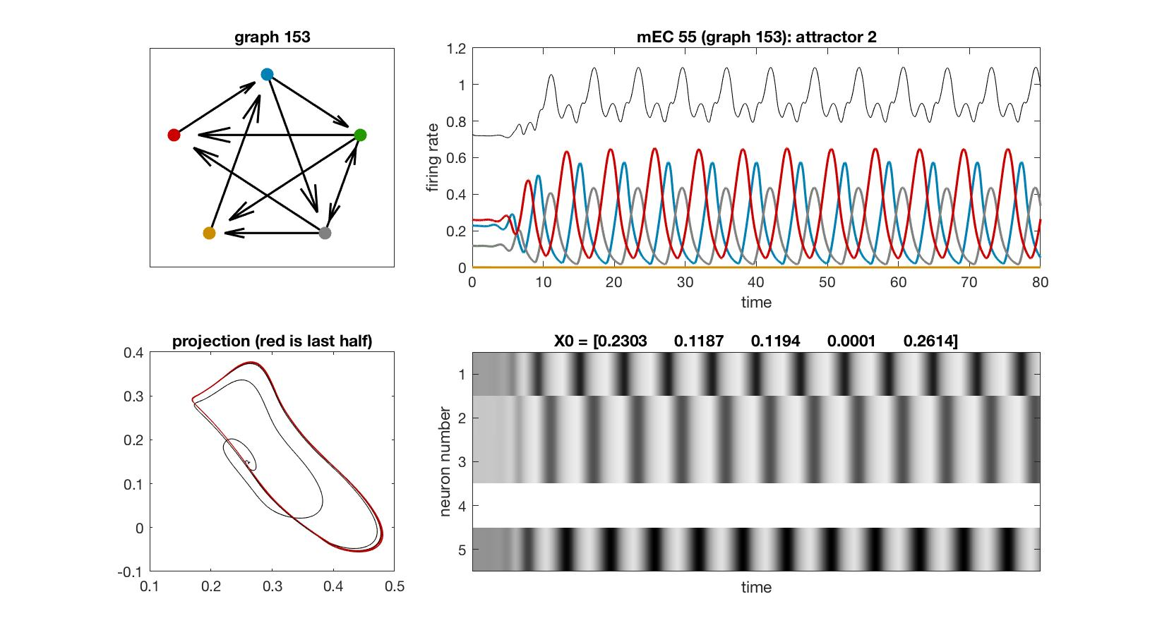
mEC 55

Slide 63
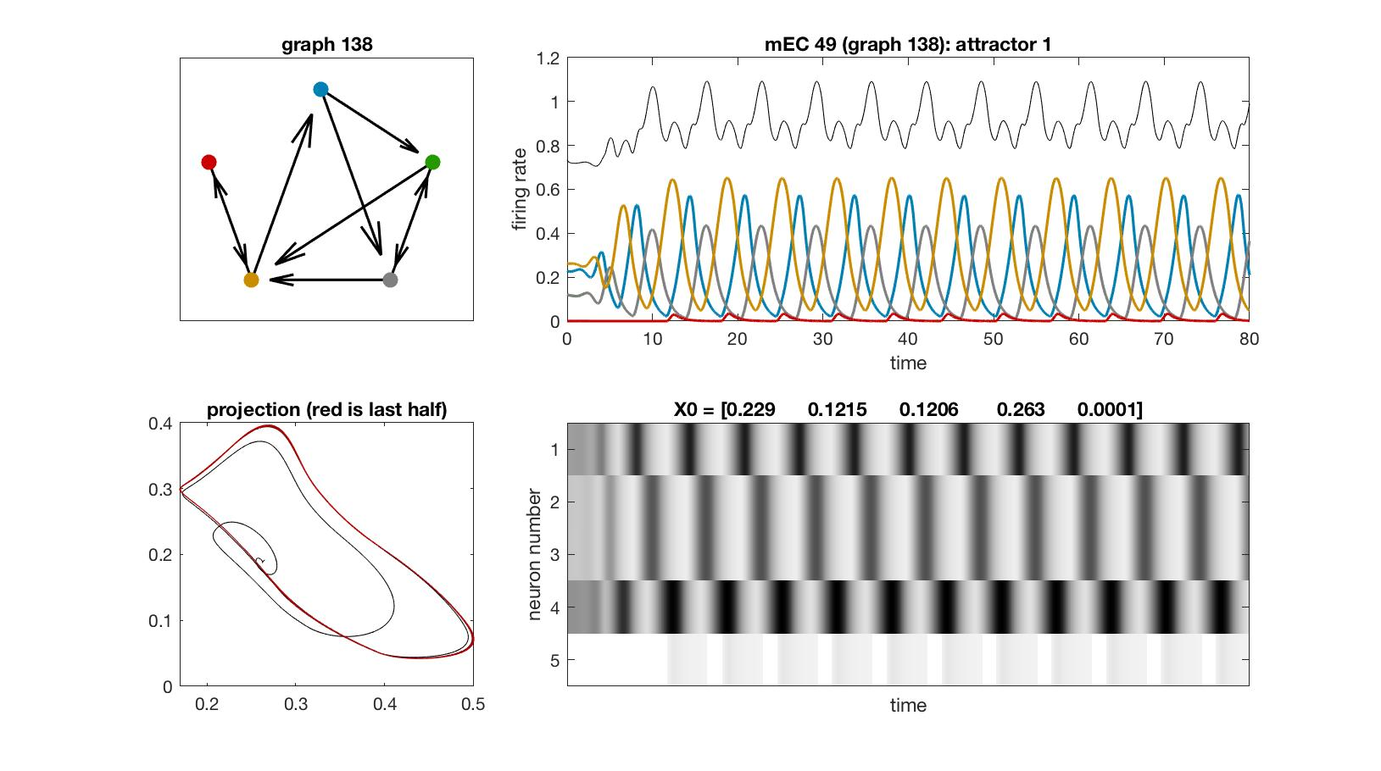
mEC 49

Slide 64
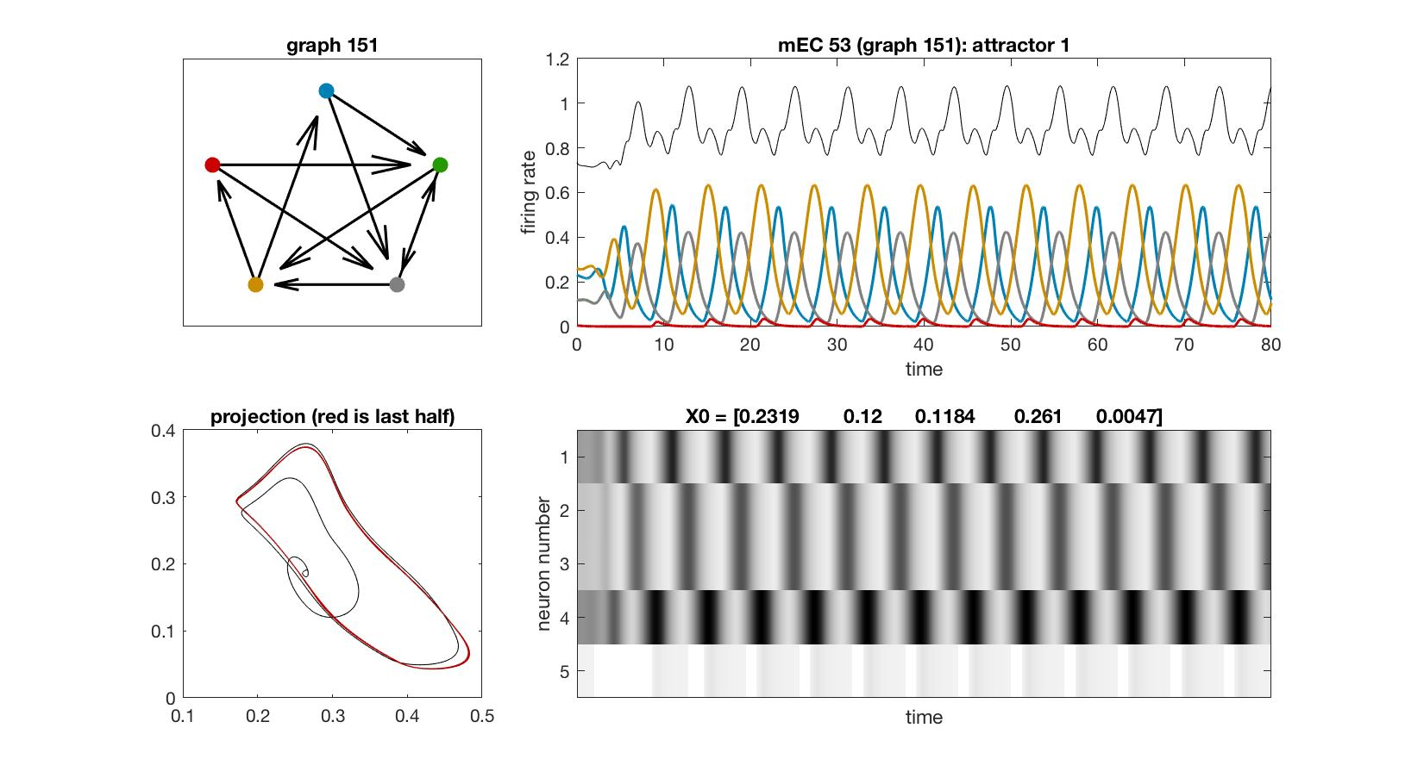
mEC 53

Slide 65
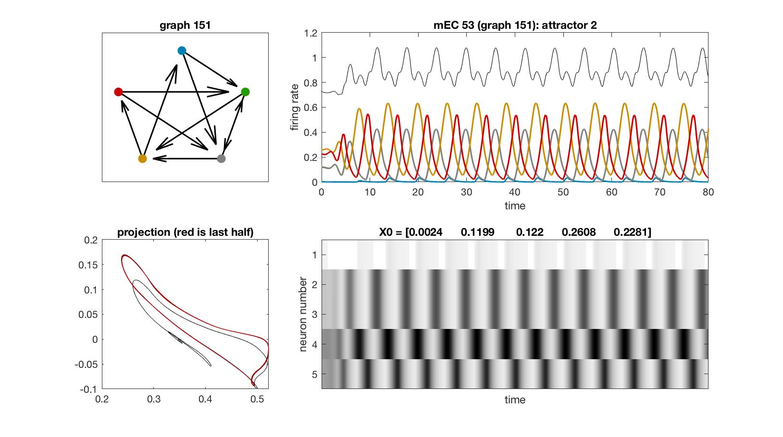
mEC 53

Slide 66
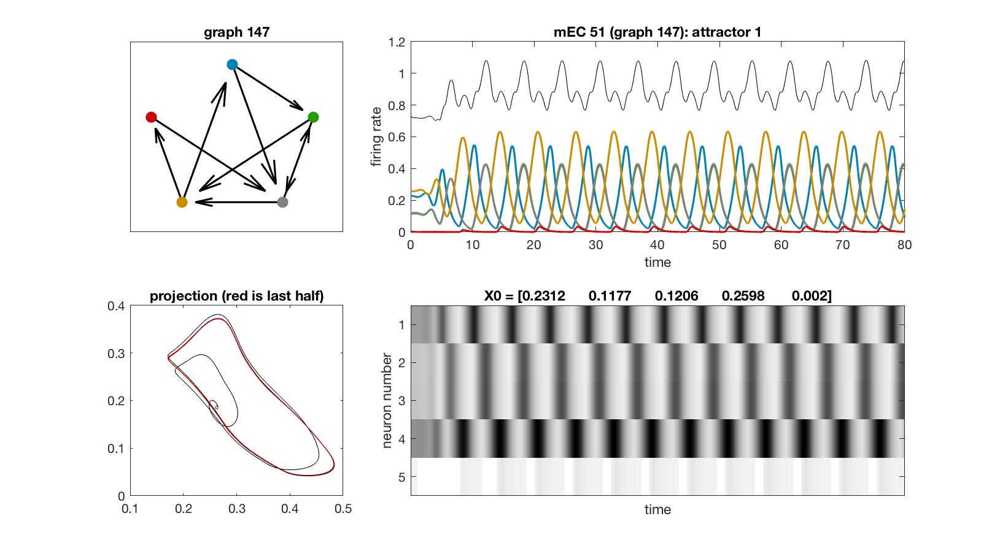
mEC 51

Slide 67

mEC 45

Slide 68

mEC 48

Slide 69

mEC 54

Slide 70

mEC 54

Slide 71

mEC 68

Slide 72
4-ufd

Slide 73

mEC 56

Slide 74

mEC 57

Slide 75

mEC 58

Slide 76

mEC 59

Slide 77

mEC 60

Slide 78

mEC 61

Slide 79

mEC 62

Slide 80

mEC 63

Slide 81

mEC 64

Slide 82

mEC 65

Slide 83

mEC 66

Slide 84

mEC 67

Slide 85

mEC 68

Slide 86

mEC 72

Slide 87

mEC 72

Slide 88

mEC 73

Slide 89

mEC 73

Slide 90

mEC 74

Slide 91

mEC 74

Slide 92

mEC 70

Slide 93

mEC 70

Slide 94

mEC 71

Slide 95

mEC 71

Slide 96

mEC 75

Slide 97
4-cycu and 4-ufd oddballs

Slide 98

mEC 56

Slide 99

mEC 45

Slide 100

mEC 45

Slide 101

mEC 69

Slide 102

mEC 61

Slide 103

mEC 56

Slide 104

mEC 39

Slide 105
Extended 4-cycu

Slide 106

mEC 11

Slide 107

mEC 12

Slide 108

mEC 13

Slide 109

mEC 14

Slide 110

mEC 15

Slide 111
Cyclic union: point + 2-clique + 2-clique

Slide 112

mEC 25

Slide 113

mEC 26

Slide 114

mEC 27

Slide 115

mEC 28

Slide 116

mEC 29

Slide 117

mEC 30

Slide 118

mEC 31

Slide 119
Cyclic union: point + 3-clique + point

Slide 120

mEC 16

Slide 121

mEC 17

Slide 122

mEC 18

Slide 123
Cyclic union: point + 3-cycle + point

Slide 124

mEC 19

Slide 125

mEC 20

Slide 126

mEC 21

Slide 127

mEC 22

Slide 128

mEC 23

Slide 129

mEC 24

Slide 130

mEC 24

Slide 131
Envelopes

Slide 132

mEC 32

Slide 133

mEC 33

Slide 134

mEC 34

Slide 135

mEC 35

Slide 136

mEC 36

Slide 137

mEC 56

Slide 138

mEC 37

Slide 139

mEC 38

Slide 140
Fusion 3-cycle

Slide 141

mEC 97

Slide 142

mEC 98

Slide 143

mEC 99

Slide 144

mEC 100

Slide 145

mEC 101

Slide 146

mEC 102

Slide 147

mEC 102

Slide 148

mEC 103

Slide 149

mEC 103

Slide 150

mEC 66

Slide 151

mEC 10

Slide 152
Other fusions: 4-cycle, 4-cycu, 4-ufd

Slide 153

mEC 7

Slide 154

mEC 8

Slide 155

mEC 9

Slide 156
5-cycle variations

Slide 157

mEC 1

Slide 158

mEC 2

Slide 159

mEC 3

